Slide 1
Hand Hygiene
Key Stage 1

Slide 2
Learning Intention
Explore and understand how soap and sanitisers help remove microbes, and develop an appreciation for the importance of proper hand washing as the most effective method for maintaining hygiene and preventing the spread of germs.

Slide 3
Northern Ireland Curriculum Links
Curriculum Key Elements
Personal Health and Moral Character
Curriculum Skills
Communication, Managing Information, Thinking, Problem Solving and Decision Making, Working with others
Curriculum Areas of Learning
Personal Development (PDMU), The World Around Us (TWAU)

Slide 4
Why Do We Wash Our Hands?
We wash our hands to not only remove any dirt and grime that we can see, but also to remove germs (microbes) that we cannot see.
Because we use our hands all the time, they pick up millions of germs (microbes) every day. Although many of these are harmless some could be harmful and might make us ill.
Our skin is naturally covered in oils and this oil helps microbes ‘stick’ to our skin. This means we need to wash our hands properly with both soap and water to be able to wash away the germs from our hands.
If no soap is available, hand sanitiser gels can also remove germs from our hands.

Slide 5
Main Activity:
Pepper and Water Experiment

Slide 6

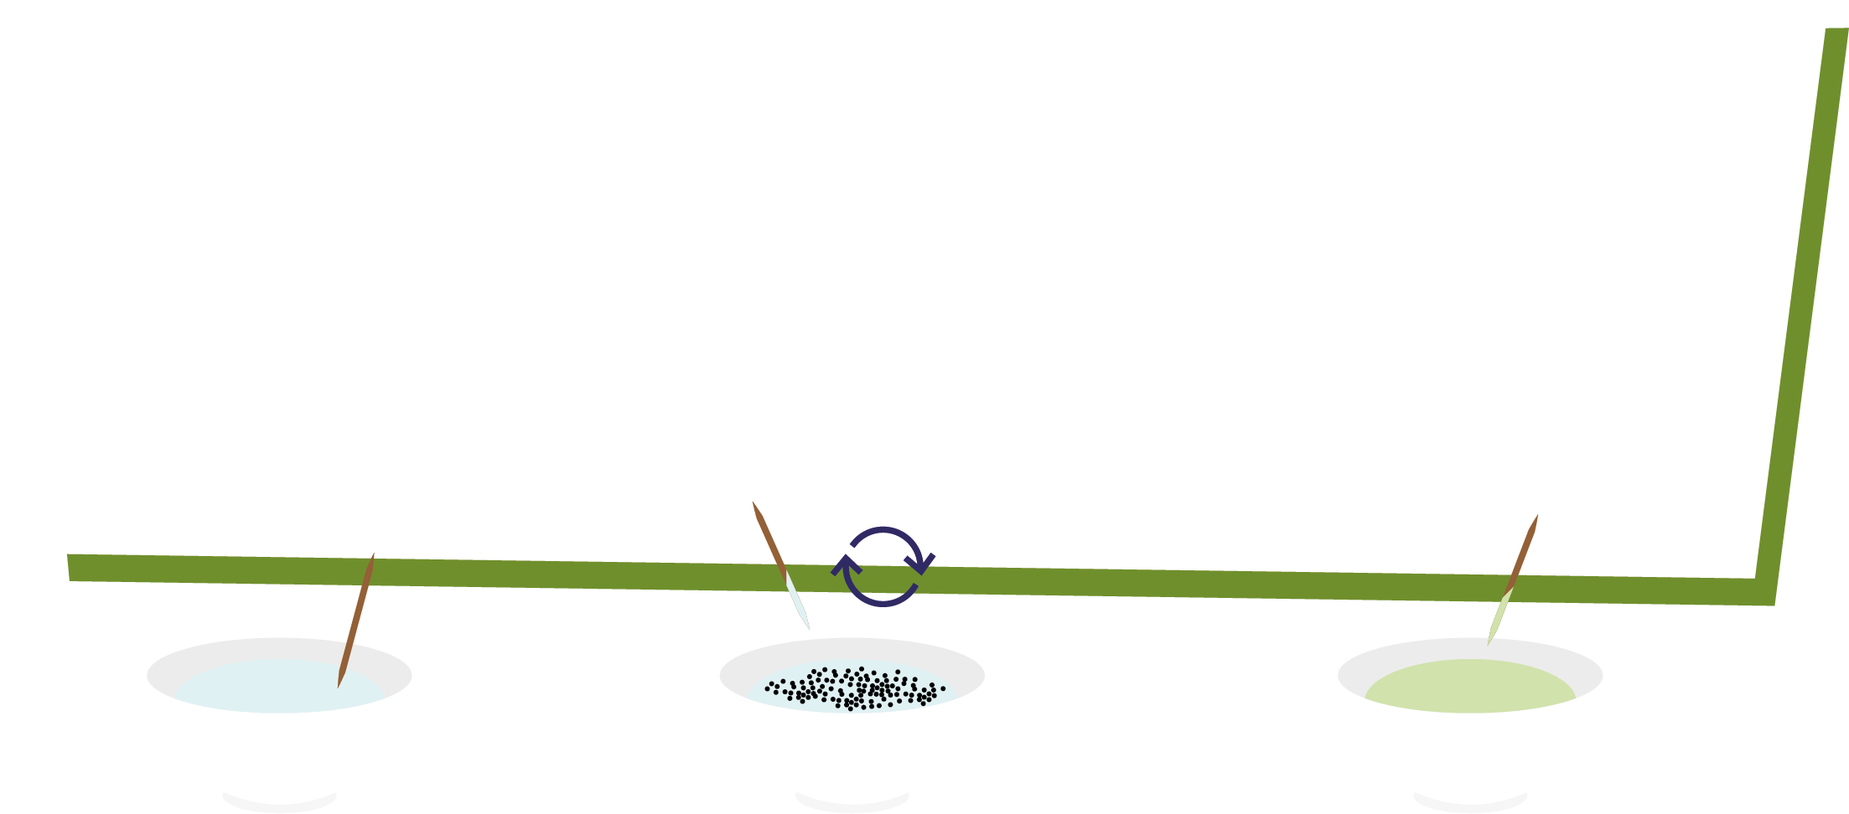
Pepper and Water Experiment
1. Dip the cocktail stick into the plain water
plain water
2. Dip the cocktail stick into the pepper water and swirl the stick around
3. Dip the cocktail stick into the soap then back into the pepper water. What happens?

Slide 7
Discussion

Slide 8
Discussion Points
Why do we wash our hands?
Where do microbes on our hands come from?
Are all microbes harmful?
When and how do we wash our hands?

Slide 9
Extension Activities

Slide 10
Healthy Hands Facts (1/2)
What makes our hands dirty?
We get microbes on our hands from everything that we touch like door handles, school desks, the floor or our pets.
We also get microbes on our hands when we hold hands, pick our nose or sneeze into our hands.
Why should we wash our hands?
We wash our hands to get rid of harmful microbes that might make us poorly. It is important that we wash our hands after using the toilet, before eating or cooking, after stroking animals or after coughing or sneezing.

Slide 11
Healthy Hands Facts (2/2)
Most microbes on our hands are under our fingernails.
Nearly everyone says they wash their hands after using
the toilet, but more than half don’t!
Most toilet handles have 400 times more microbes than
the toilet seat.
There are more microbes on one person’s hand than
people on the planet.
Hand washing is the best way to stop microbes
spreading.
Some microbes can stay alive on our hands for up to 3 hours

Slide 12
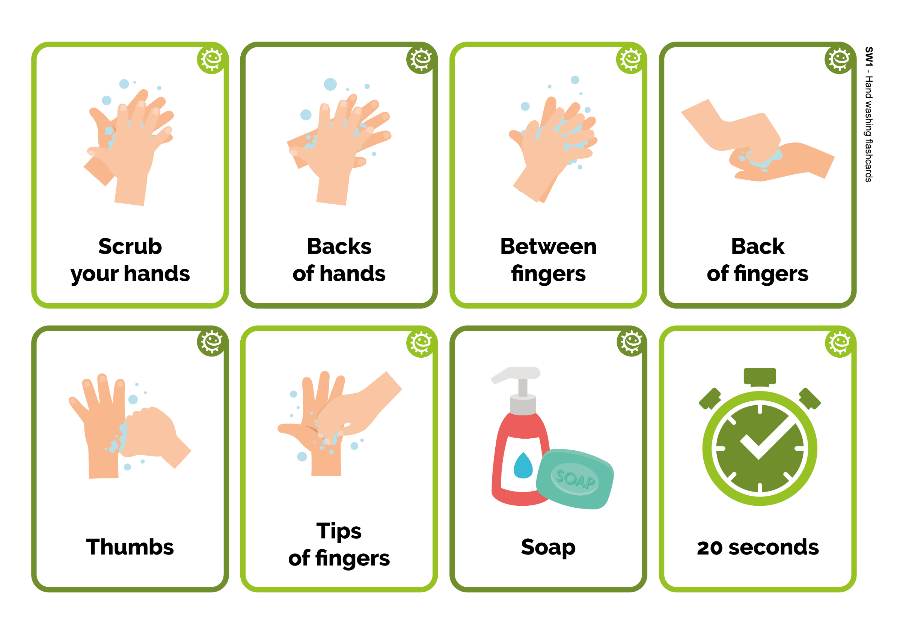
Hand Washing Flashcards
Scrub
your hands
Back
of fingers
Between fingers
Thumbs
Backs
of hands
Tips of fingers
20 seconds
Soap

Slide 13
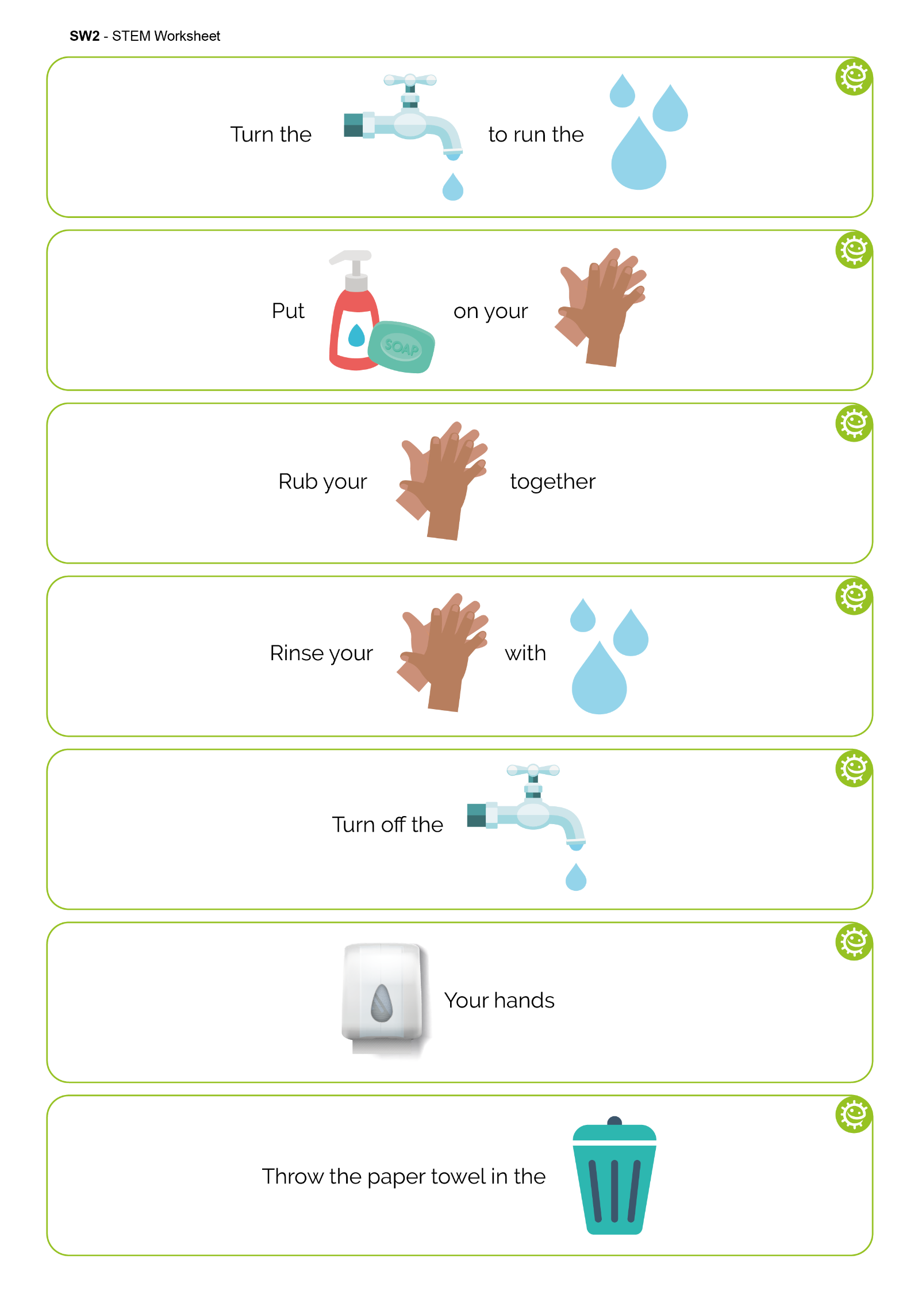
Fill in the Blanks (1/2)
Turn the
to run the
tap
water
Put
on your
soap
hands
Rub your
together
hands

Slide 14

Fill in the Blanks (2/2)
Rinse your
with
hands
water
Turn off the
tap
Your hands
Dry
Throw the paper towel in the
bin

Slide 15
Learning Consolidation

Slide 16
A song to use when washing my hands is…
Happy Birthday To You

Slide 17
I will wash my hands at key moments during the day, for example
After using the toilet
After stroking animals
Before eating or cooking
After coughing or sneezing

Slide 18
There are how many steps to wash every part of my hands?
8 Steps To Follow
Scrub
your hands
Backs
of hands
Between fingers
Back
of fingers
Tips of fingers
20 seconds
Thumbs
Soap

Slide 19
If I am not able to wash my hands with soap and water, I will use…
Hand Sanitizer Gel

Slide 20
At the end of the lesson, ask the class to pair up and discuss their responses for the following sentences:
A song to use when washing my hands is: ___________________________
I will wash my hands at key moments during the day, for example: ______________
There are how many steps to wash every part of my hands?
If I am not able to wash my hands with soap and water, I will use ___________
Then ask the class to complete the sentences with their own answers individually.

