Slide 1
Introduction to
Micro-organisms
Key Stage 1

Slide 2
Learning Intentions
All pupils will:
• Learn about the different types of microbes (viruses, bacteria and fungi), their shapes and sizes, where they can be found and how they can be both helpful and harmful.

Slide 3
Northern Ireland Curriculum Links
Curriculum Key Elements
Personal Health and Moral Character
Curriculum Skills
Communication, Managing Information, Thinking, Problem Solving and Decision Making, Working with Others
Curriculum Areas of Learning
Personal Development and Mutual Understandi(PDMU), The World Around Us (TWAU), The Arts

Slide 4
What are Microbes?
Microbes are tiny living things that are all around us; most of these are too small to be seen with our naked eyes.
Some illnesses called infections, are caused by these tiny living things called microbes and there are three different types of microbes: viruses, bacteria and fungi.
Some microbes make us ill, there are also useful microbes, for example, bacteria help to make foods like yoghurt, and fungi like yeast help make bread, while other fungi are used as medicines.
Microbes can be found EVERYWHERE: floating around in the air we breathe, on the food we eat, on the surface of our bodies, in our mouth, nose and gut/tummy, most of these are not harmful and some are good for us.

Slide 5
Main Activity:
Modelling Microbes

Slide 6

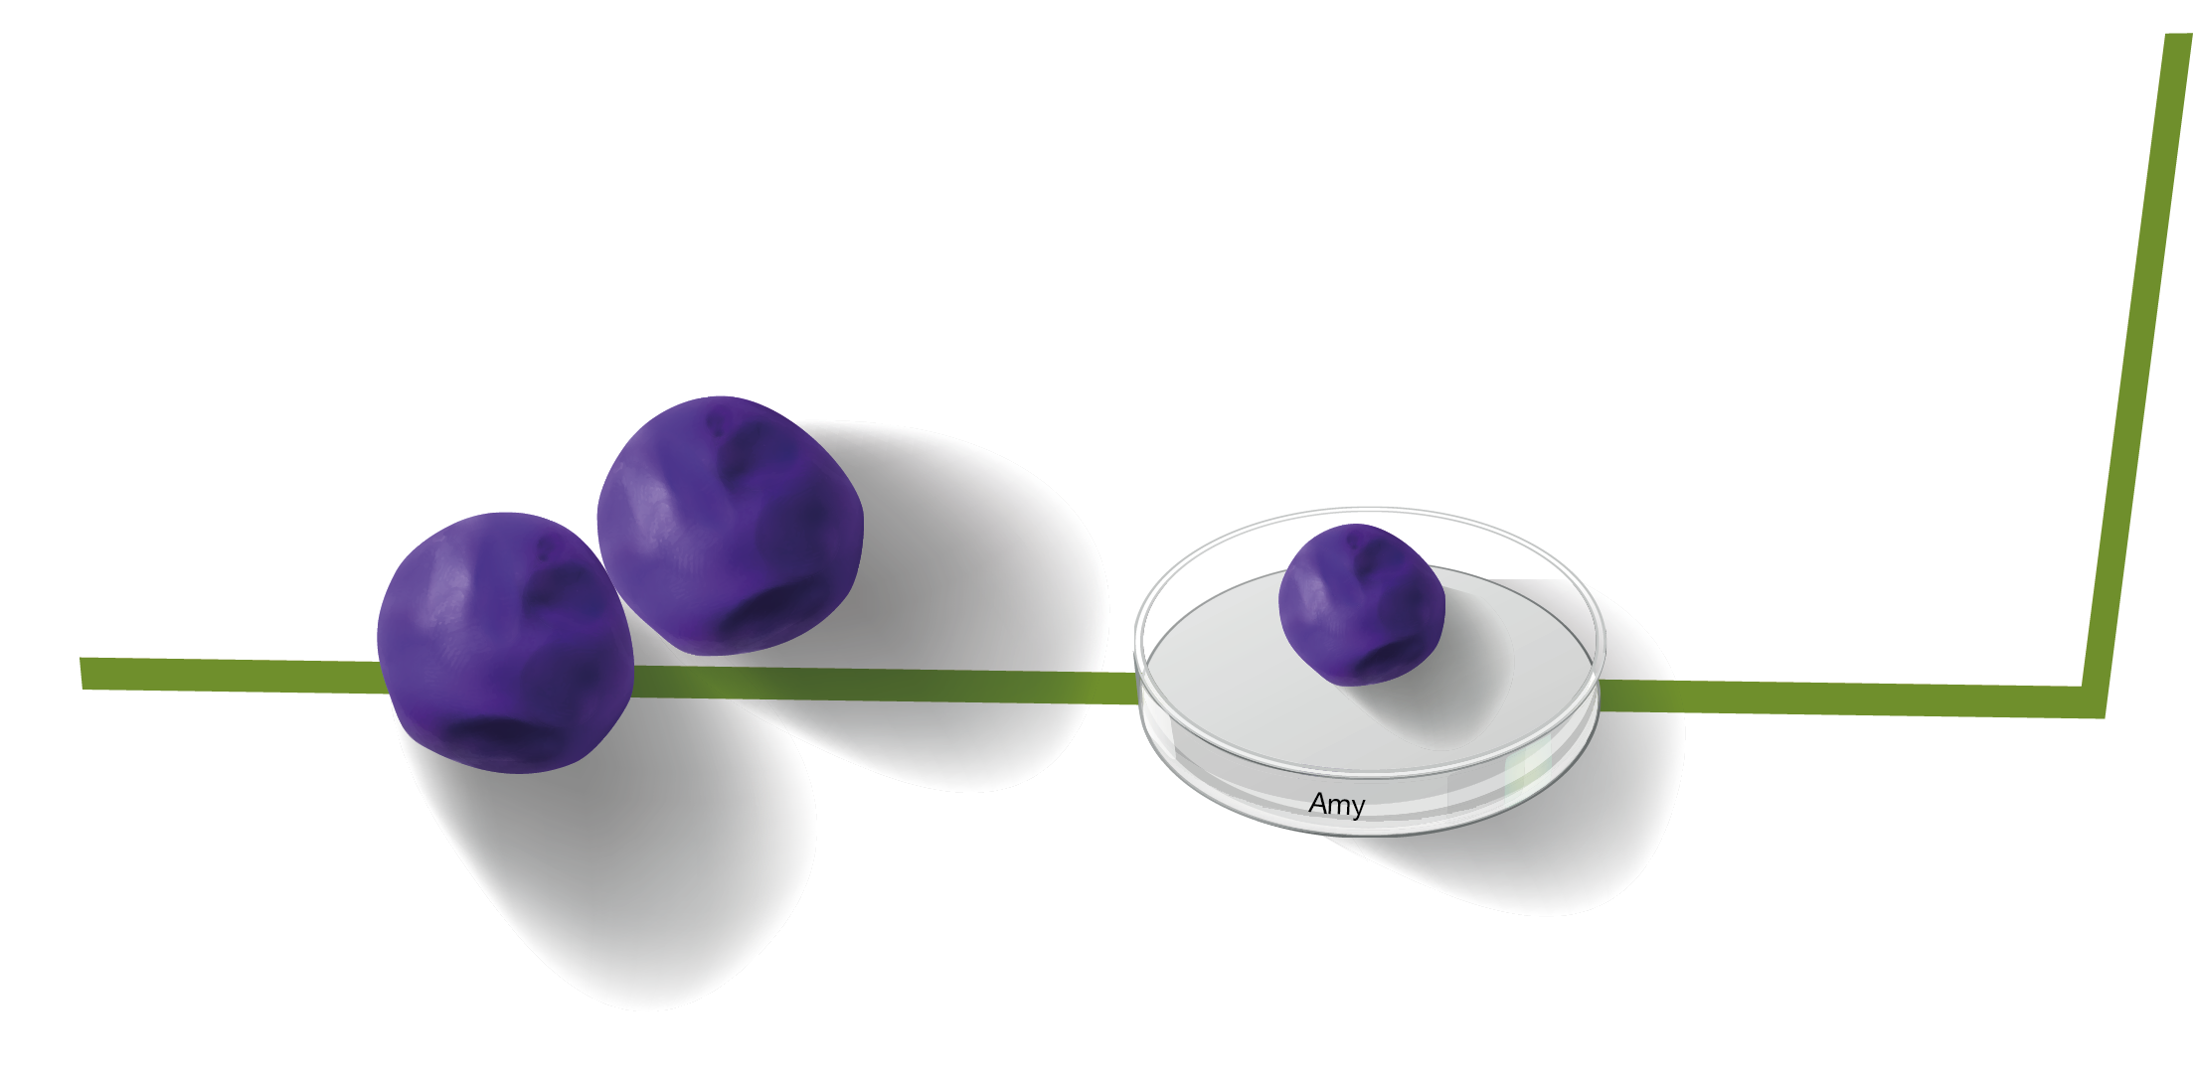
=
1. Shape your microbe using modelling clay
2. Place onto a Petri dish
3. Write the name of your microbe on your Petri dish
4. Take your Petri dish home

Slide 7
Discussion

Slide 8
Discussion Points
What have you made?
Are all microbes harmful?
What are three different types of microbes?
What are the difference between viruses, bacteria and fungi?

Slide 9
Extension Activities

Slide 10
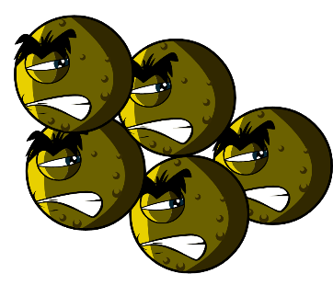
Microbe Mania Fact Sheet
What is a microbe?
Microbes are also called germs or bugs. There are three types of microbes: bacteria, viruses and fungi. Some microbes can make us ill, but most are very useful to us.
Where are microbes found and what do they look like?
Microbes are found everywhere. They come in all shapes and sizes.

Slide 11
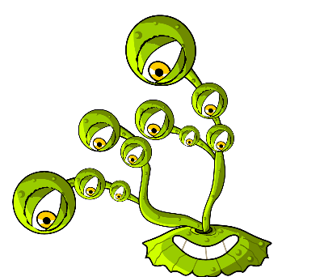
Microbe Fascinating Facts
There are more microbes on the planet than any other type of living thing.
Microbes are the oldest form of life on Earth. They’ve been here for four billion years!
Microbes are found everywhere on Earth, even inside volcanoes.
Some microbes can glow in the dark. People once used glowing pieces of fungi growing on wood to light the way.
Humans would not be able to live without microbes. Some microbes produce oxygen which we need to breathe, and others help plants to grow which we eat.
Micro-organisms first appeared on earth about 3.5 billion years ago and are essential to sustain life on our planet.

Slide 12
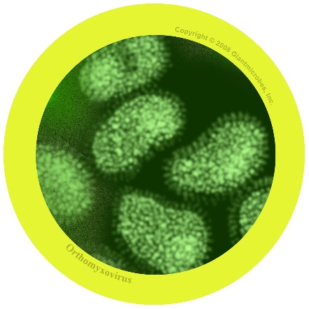
Microbe Example - Influenza
Influenza virus
In-floo-en-za
About
Also known as the flu virus
It is a virus that is harmful to humans
Symptoms and treatment
Causes fever (high temperature), runny nose, sore throat, muscle pains, cough, feeling tired
Spreads from person to person by coughs and sneezes and unwashed hands
Treatment is rest and plenty of fluids to feel better. If very unwell, an antiviral medicine may help.

Slide 13
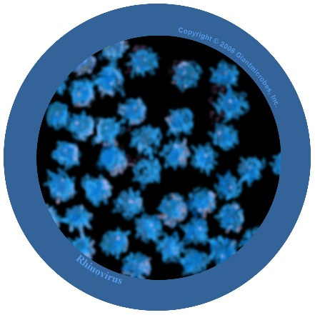
Microbe Example - Rhinovirus
Rhinovirus
Rye-no-vye-rus
About
Also known as the common cold
It is a virus that is harmful to humans
Symptoms and treatment
Causes runny nose, sneezing, sore throat, and coughing
Spreads from person to person by coughs and sneezes and unwashed hands
Treatment is rest and plenty of fluids to feel better.

Slide 14
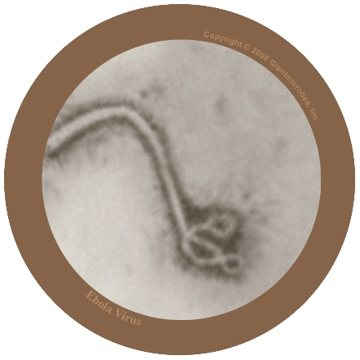
Microbe Example - Filovirus
Filovirus
File-o-vi-rus
About
Filovirus is harmful to humans and causes a disease called Ebola.
It has been in the news as people living in Africa have caught the virus and many have died.
The virus lives naturally in wild animals in Africa and is not found in other continents.
Symptoms and treatment
Ebola virus makes people very unwell and in worst cases, death.
People with Ebola will need special treatment and hospital care to help get better.

Slide 15
Yes or No? (1/2)
Microbe is another name for bugs and germs
Most microbes can be seen with the naked eye
YES
NO
Most colds are caused by viruses
Microbes always make us poorly
YES
NO

Slide 16
Yes or No? (2/2)
Bacteria are used to make yoghurt
If you become poorly because of a microbe, this is called an infection
YES
Most microbes do not affect us in any way
YES
You only find microbes on things that are dirty, like the toilet
YES
NO

Slide 17
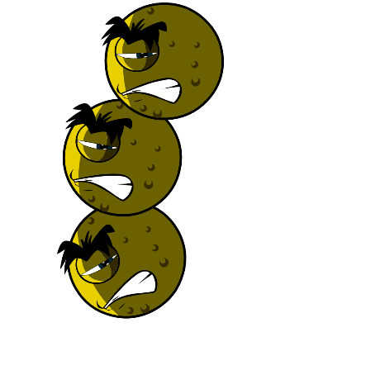
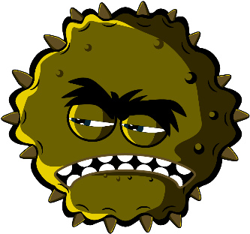



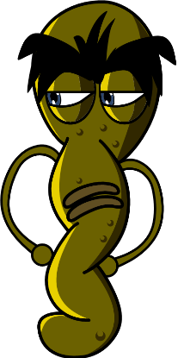


Microbes Flashcards

Slide 18
Microbes Flashcards - Answers
Virus
Bacteria
Fungi
Balls (Cocci)
Rod
Spiral
Penicillium
Lactobacilli

Slide 19




Microbe Mania – Fill in the Blank
Microbes Worksheet
What have you learnt about microbes?
Complete the sentences below
Germs and bugs are also called _ _ _ _ _ _ _ _
and there are three main types.
The smallest microbe is a _ _ _ _ _ and they can make us poorly with a cough or a cold.
The largest microbe is a _ _ _ _ _ _. We use this to make bread.
Balls, rods and spirals are the three main
shapes of _ _ _ _ _ _ _ _.
Microbes are found _ _ _ _ _ _ _ _ _ _ and even in volcanoes!

Slide 20
Microbe Mania – Fill in the Blank -
Answers
Microbes Worksheet
What have you learnt about microbes?
Complete the sentences below
Germs and bugs are also called _ _ _ _ _ _ _ _ _ _
and there are three main types.
The smallest microbe is a _ _ _ _ _ _ _ _ _ _ and they can make us poorly with a cough or a cold.
The largest microbe is a _ _ _ _ _ _ _ _ _ _. We use this to make bread.
Balls, rods and spirals are the three main
shapes of _ _ _ _ _ _ _ _ _ _.
Microbes are found _ _ _ _ _ _ _ _ _ _ and even in volcanoes!
microbes
virus
fungi
bacteria
everywhere

Slide 21
Microbe Mania – Fill in the Blank
Share the worksheet with the class on the interactive white board and complete it together. Or if appropriate, ask pupils to complete it individually.
Alternatively, ask pupils to come up with their own quiz questions to test each other’s knowledge.
You could also task pupils to create their own e-book or slide presentation about what they have learned under the headings of:
What are microbes?
Where do they live?
Different types of microbes
Photographs of their clay microbes and a description of what it is and what it does.

Slide 22
Learning Consolidation

Slide 23
What are the three different types of microbes?
Viruses
Fungi
Bacteria

Slide 24
Microbes can be beneficial to us e.g. yeast, can be used to make bread rise. What type of microbe is yeast?
Fungus

Slide 25
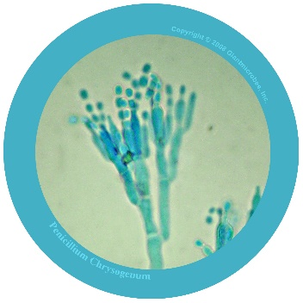

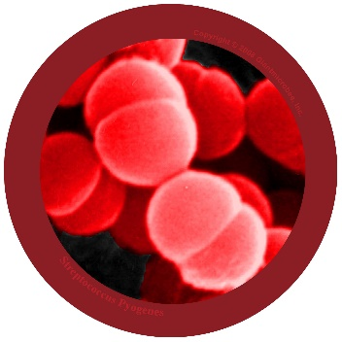
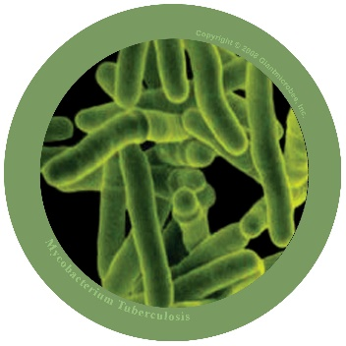
Microbes are invisible to the naked eye and come in different shapes and sizes.
True or False?
True
Microbes are tiny living things that are all around us; most of these are too small to be seen with our naked eyes.

