Slide 1
Spread of Infection: Food Hygiene
Key Stage 2

Slide 2
Learning Intention
All pupils will:
• Understand how microbes can be present in food, the importance of proper cooking and storage to prevent illness, and how to safely manage food to reduce the risk of infection.

Slide 3
Northern Ireland Curriculum Links
Curriculum Key Elements
Personal Health and Moral Character
Curriculum Skills
Communication, Thinking, Problem Solving and Decision Making, Being Creative, Working with Others
Curriculum Areas of Learning
Personal Development and Mutual Understanding (PDMU), The World Around Us (TWAU)

Slide 4
How Harmful Microbes can Enter our Bodies Through the Food we Eat?
Some microbes like to grow in nice warm damp places, such as inside our bodies, and when they find somewhere they like, they grow and multiply. But they usually don’t like places that are very warm or cold.
Putting food in the fridge only slows or stops microbial growth, it doesn’t kill it. The microbes will grow again when they come out of the fridge.
The only way to kill microbes is to cook food until it is really hot and cooked all the way through. This is because very warm temperatures kill many harmful microbes.

Slide 5
Main Activity:
Kitchen Check

Slide 6

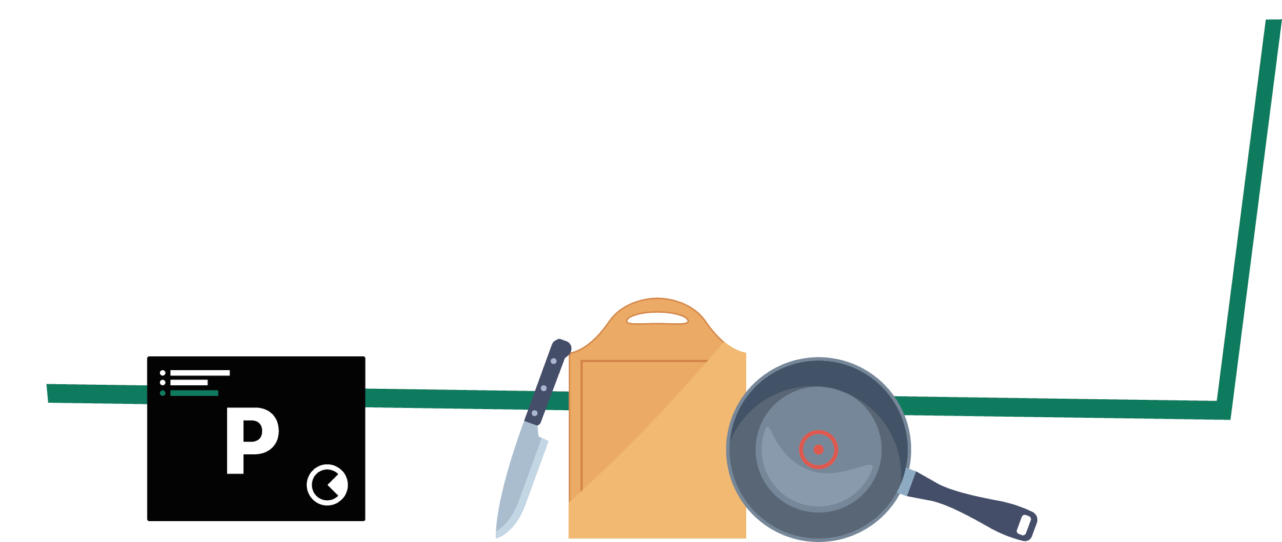
Kitchen Check Activity
1. Open the Kitchen
Check MS PowerPoint quiz
2. Make decisions about preparing a meal
3. Learn about good food hygiene along the way

Slide 7
Kitchen Check MS PowerPoint Quiz

Slide 8





Kitchen Check
Follow the quiz to find out how to make sure the food you prepare is safe.
This is designed to be interactive so make sure to play the slideshow and click on the options you choose.

Slide 9
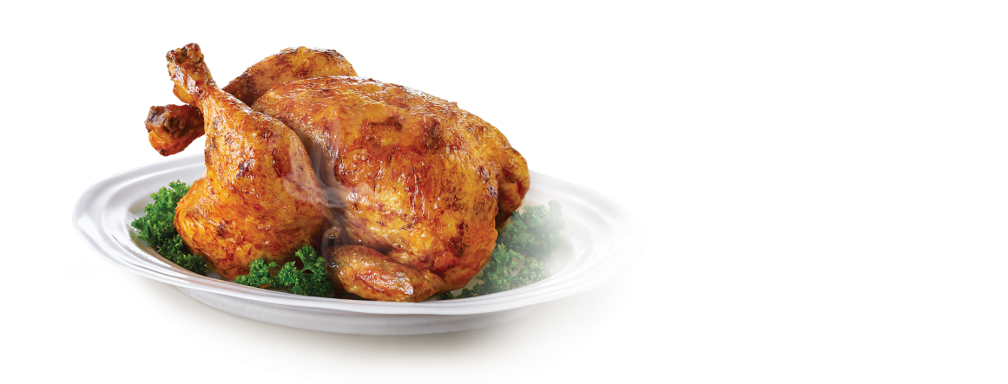
Instructions:
You are about to prepare a meal but you need to decide at each stage what to do next!
Click on your answer and become a food hygiene expert!
Begin

Slide 10
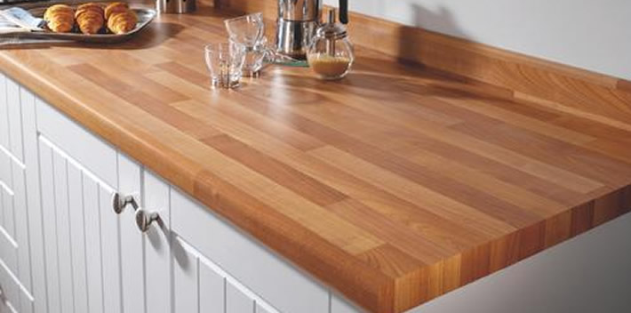
Food Preparation Question 1
You are about to prepare food for a friend.
Tonight's menu is roast pork with vegetables.
Click on one option for the next step:
You get your chopping board out ready
You wipe down the surfaces with hot soapy water using a clean cloth

Slide 11
Food Preparation Q1 – Correct
You are about to prepare your food.
Tonight's menu is roast pork with vegetables.
Click on one option for the next step:
Great! It’s always a good idea to give the surfaces a wipe down before food preparation. Just in case they are unclean.
You get your chopping board out ready
You wipe down the surfaces with hot soapy water using a clean cloth
Next

Slide 12
Food Preparation Q1 – Incorrect
You are about to prepare your food.
Tonight's menu is roast pork with vegetables.
Click on one option for the next step:
It’s a good idea to wipe down your surface before you get started. This is so microbes on your kitchen surfaces don’t get onto the food you are about to prepare.
You get your chopping board out ready
You wipe down the surfaces with hot soapy water using a clean cloth
Next

Slide 13
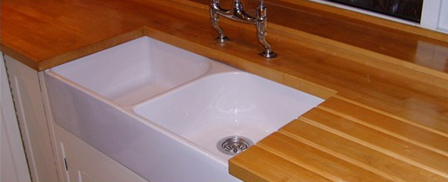
Food Preparation Question 2
You are now about to get your food from the fridge but first you wash your hands:
Click on one option for the next step:
You use soap and warm water to wash your hands
You give them a quick rinse before you get your food out

Slide 14
Food Preparation Q2 – Incorrect
You are now about to get your food from the fridge but first you wash your hands:
Click on one option for the next step:
It’s a good idea to wash your hands thoroughly before touching any food. This will make sure there are no harmful microbes on your hands.
You use soap and warm water to wash your hands
You give them a quick rinse before you get your food out
Next

Slide 15
Food Preparation Q2 – Correct
You are now about to get your food from the fridge but first you wash your hands:
Click on one option for the next step:
Great! Washing your hands with soap and warm water will make sure you don’t have any harmful microbes on your hands.
You use soap and warm water to wash your hands
You give them a quick rinse before you get your food out
Next

Slide 16
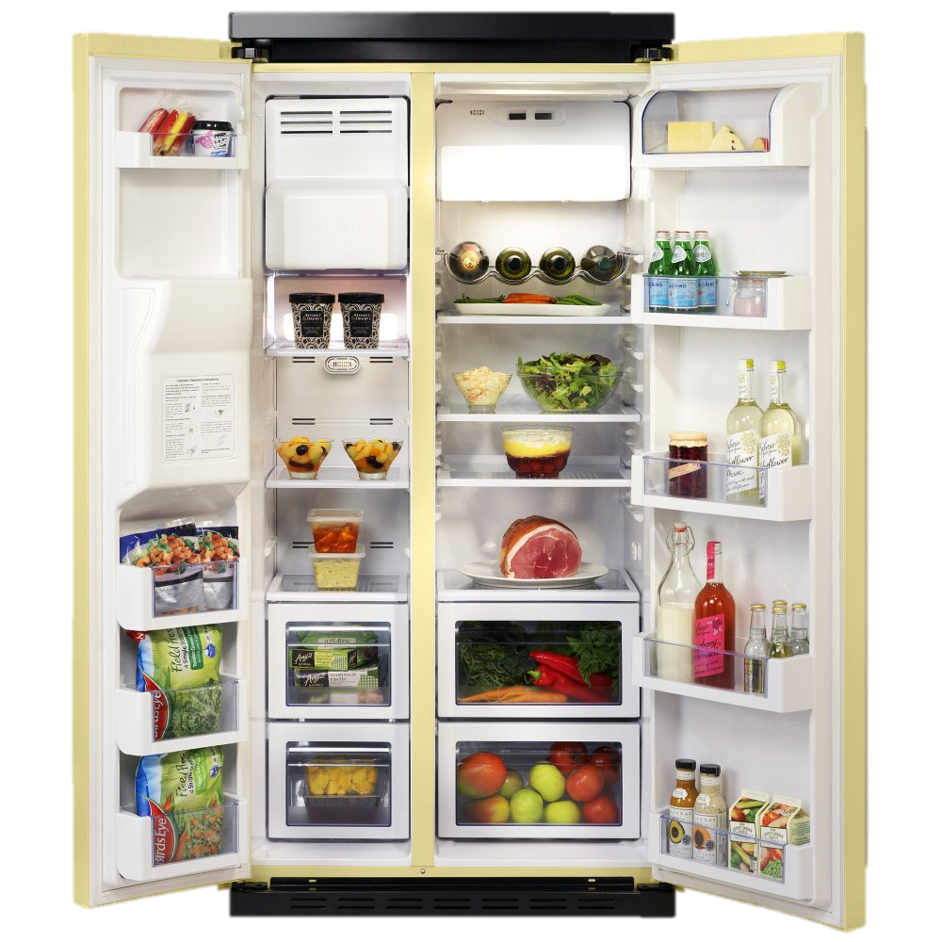

Food Preparation Question 3
5ºC
0ºC
You go to the fridge to get the food.
Would you change anything about this fridge?
Yes. I would cover the meat and other uncovered items.
No. Everything in the fridge looks fine the way it is.

Slide 17
Food Preparation Q3 – Correct
5ºC
0ºC
Great! Covering the meat and other items can prevent harmful microbes on food from contaminating other products. The fridge is also between 0 and 5 degrees meaning microbes won’t grow too.
You go to the fridge to get the food.
Would you change anything about this fridge?
Yes. I would cover the meat and other uncovered items.
No. Everything in the fridge looks fine the way it is.
Next

Slide 18
Food Preparation Q3 – Incorrect
5ºC
0ºC
The meat and other items are uncovered. This can allow harmful microbes to spread from item to item. It’s a good idea to cover them. The temperature is fine though, kept between 0 and 5 degrees.
You go to the fridge to get the food.
Would you change anything about this fridge?
Yes. I would cover the meat and other uncovered items.
No. Everything in the fridge looks fine the way it is.
Next

Slide 19
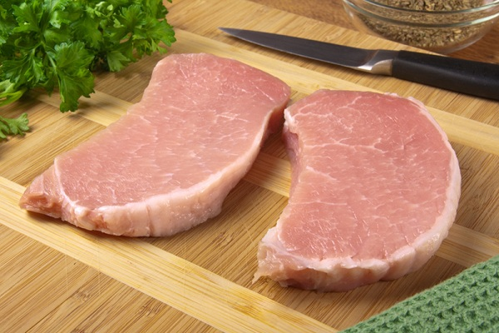
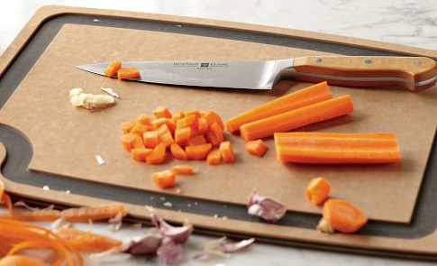
Food Preparation Question 4
You now have to chop your pork and your vegetables so that they can be cooked.
Which of the following options would you choose?
I would prepare all of my food on the same chopping board and wash when I’m finished using it
I would wash my chopping board between preparing raw and ready to eat food

Slide 20
Food Preparation Q4 – Incorrect
You now have to chop your pork and your vegetables so that they can be cooked.
Which of the following options would you choose?
If you use the chopping board for preparing raw products and ready to eat products without washing it, you could risk contaminating your meal with harmful microbes. It is good to wash the board in between foods or to use separate chopping boards for raw and ready to eat food.
I would prepare all of my food on the same chopping board and wash when I’m finished using it
I would wash my chopping board between preparing raw and ready to eat food
Next

Slide 21
Food Preparation Q4 – Correct
You now have to chop your pork and your vegetables so that they can be cooked.
Which of the following options would you choose?
Great! This will prevent cross contamination of microbes from raw to ready to eat foods. You could also prepare raw and ready to eat foods on separate chopping boards as well.
I would prepare all of my food on the same chopping board and wash when I’m finished using it
I would wash my chopping board between preparing raw and ready to eat food
Next

Slide 22
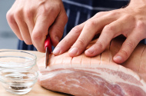
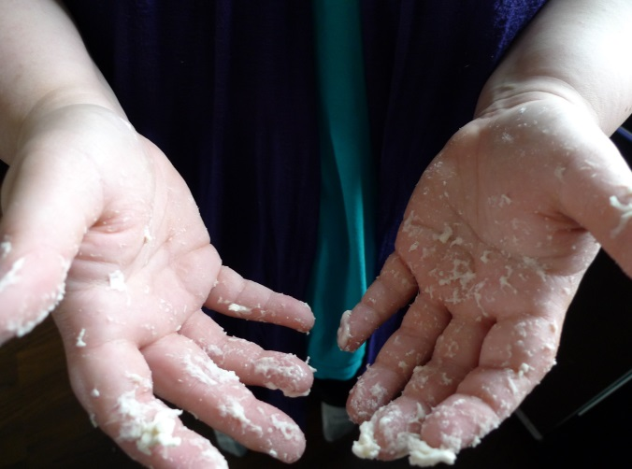
Food Preparation Question 5
After preparing the meat you find that you have got some of the juices from the meat on your hands.
What do you do next?
Click on one option for the next step:
You use soap and warm water to wash your hands
You give them a quick rinse before you prepare the vegetables

Slide 23
Food Preparation Q5 – Incorrect
After preparing the meat you find that you have got some of the juices from the meat on your hands.
What do you do next?
Click on one option for the next step:
It’s a good idea to wash your hands thoroughly before touching any other food. This will make sure there are no harmful microbes on your hands.
You use soap and warm water to wash your hands
You give them a quick rinse before you get your food out
Next

Slide 24
Food Preparation Q5 – Correct
After preparing the meat you find that you have got some of the juices from the meat on your hands.
What do you do next?
Click on one option for the next step:
Great! Washing your hands with soap and warm water will make sure you don’t have any harmful microbes on your hands to transfer elsewhere.
You use soap and warm water to wash your hands
You give them a quick rinse before you get your food out
Next

Slide 25
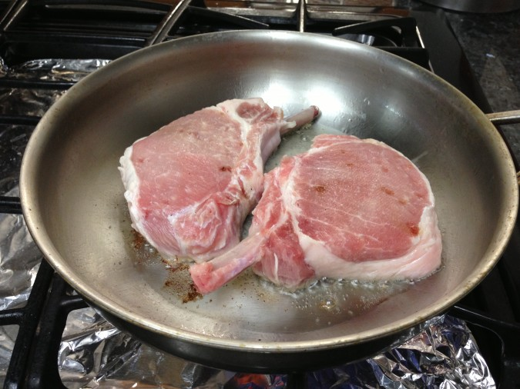
Food Preparation Question 6
You are now cooking your pork.
How will you know when it’s ready?
When it is very hot and has been in the pan for some time
When the juices run clear from the middle and it’s piping hot

Slide 26
Food Preparation Q6 – Correct
You are now cooking your pork.
How will you know when it’s ready?
Great! When the juices run clear from the thickest part and it is piping hot throughout the meat is ready to eat.
When it is very hot and has been in the pan for some time
When the juices run clear from the middle and it’s piping hot
Next

Slide 27
Food Preparation Q6 – Incorrect
Just because the food is hot doesn’t mean that the harmful bacteria that may be present have been killed. You should always make sure the your food is piping hot and juices in meat run clear when cut into.
You are now cooking your pork.
How will you know when it’s ready?
When it is very hot and has been in the pan for some time
When the juices run clear from the middle and it’s piping hot
Next

Slide 28
End of Quiz
Congratulations!
You have completed the
Kitchen Check quiz!

Slide 29
Discussion

Slide 30
Discussion Points
Why it is important to wipe your surface before cooking?
Why do we wash our hands before touching food?
Why do we need to keep meat and vegetables separately from each other and covered in the fridge?
How do you know when meat is properly cooked?

Slide 31
Extension Activities

Slide 32
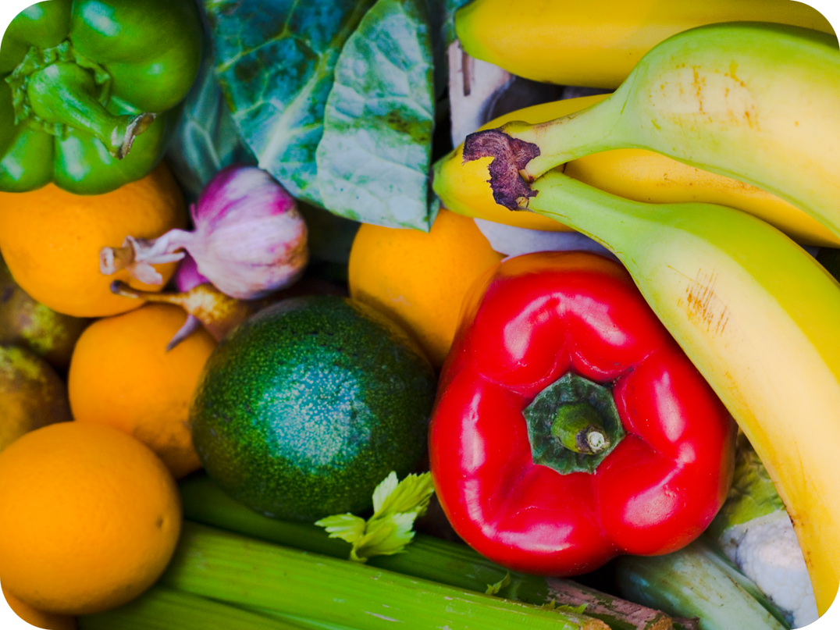
Microbes on Foods 1
Discuss the types of microbes that are commonly found on or in these foods?
Fruit and Vegetables

Slide 33
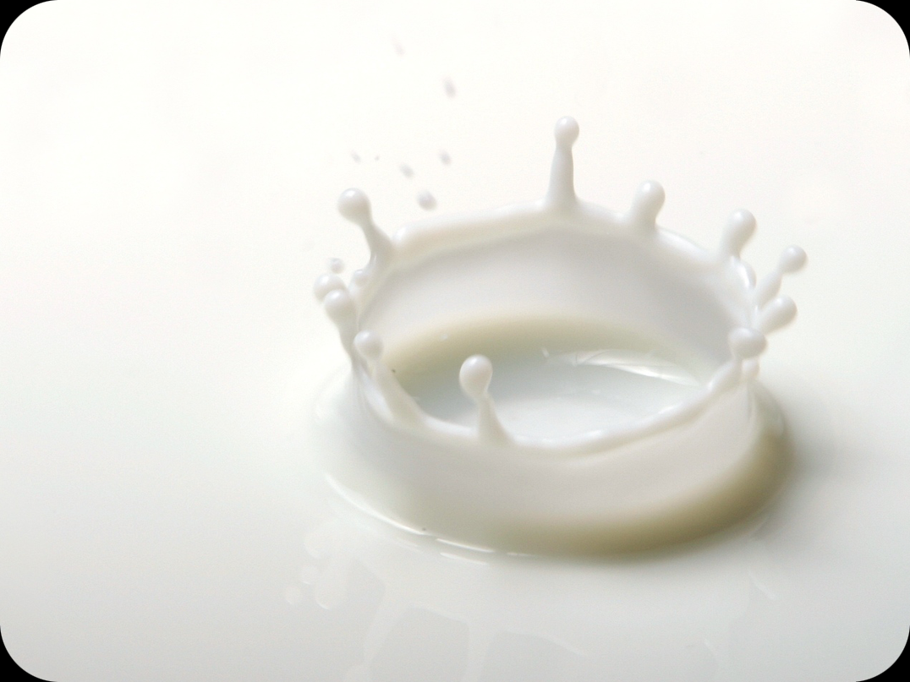
Microbes on Foods 2
Discuss the types of microbes that are commonly found on or in these foods?
Milk

Slide 34
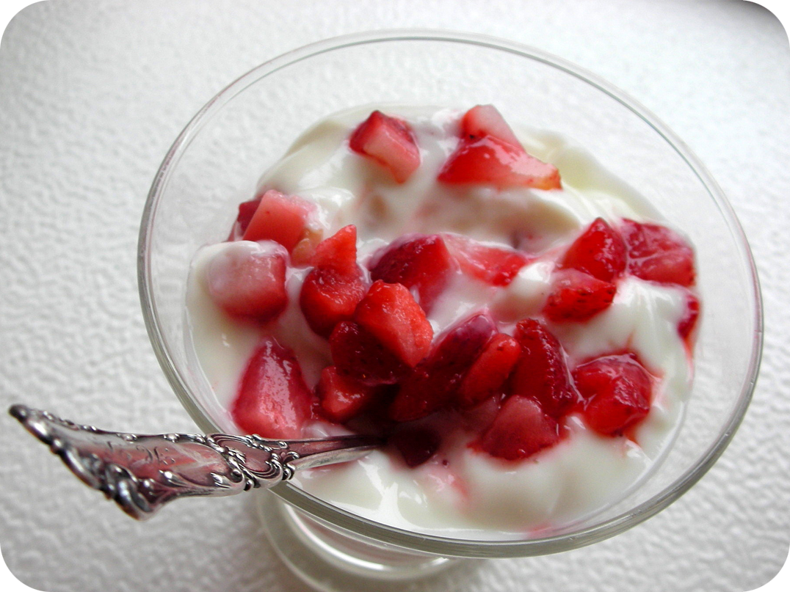
Microbes on Foods 3
Discuss the types of microbes that are commonly found on or in these foods?
Yoghurt

Slide 35
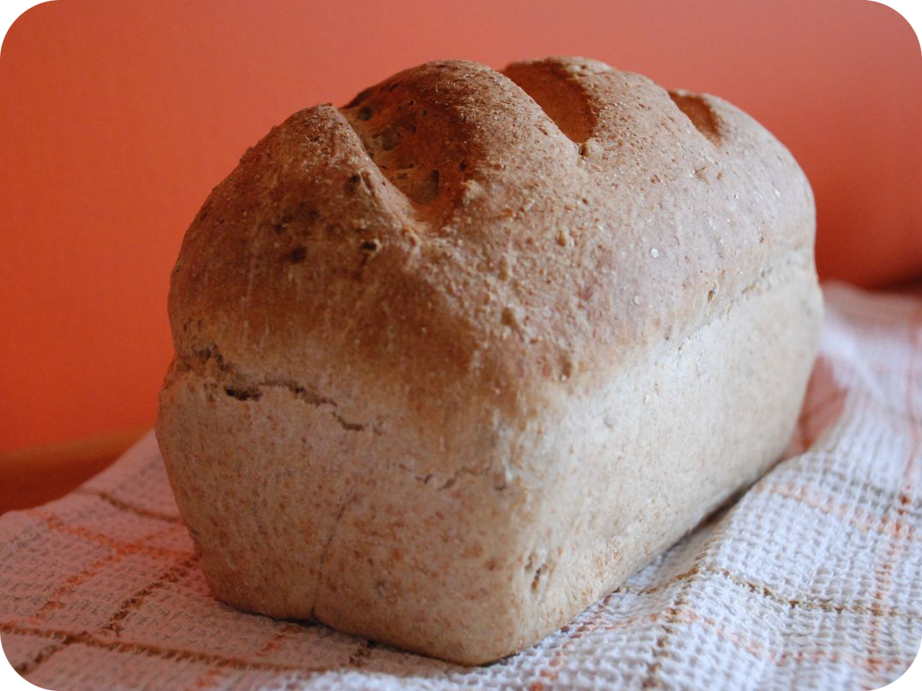
Microbes on Foods 4
Discuss the types of microbes that are commonly found on or in these foods?
Bread

Slide 36
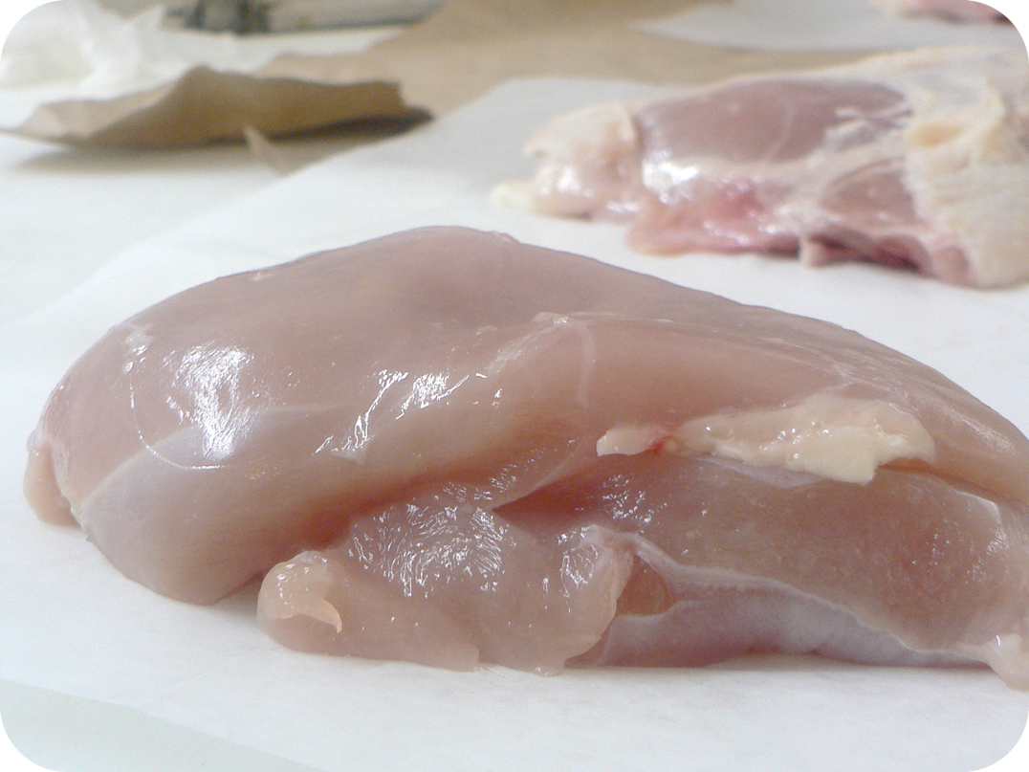
Microbes on Foods 5
Discuss the types of microbes that are commonly found on or in these foods?
Chicken

Slide 37
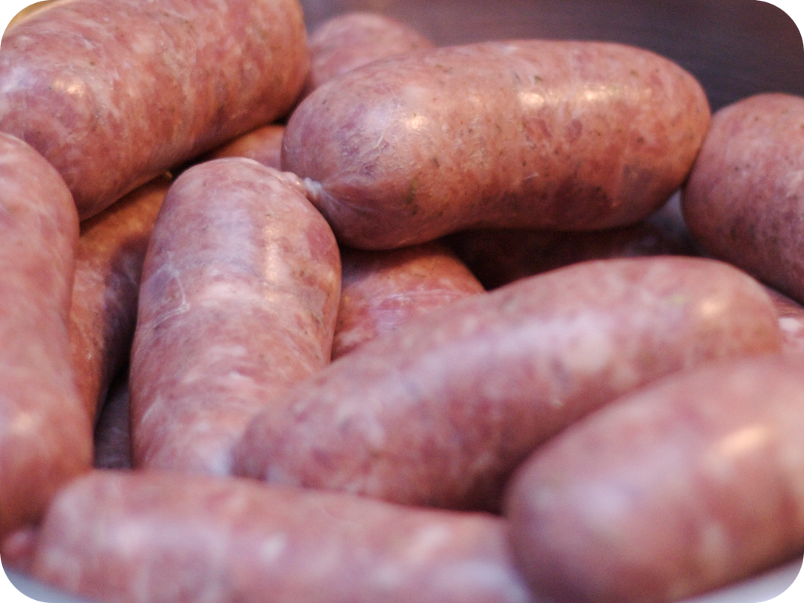
Microbes on Foods 6
Discuss the types of microbes that are commonly found on or in these foods?
Sausages

Slide 38
Microbes on Foods 1 – Answers
Discuss the types of microbes that are commonly found on or in these foods? - Answers
Most of the microbes
found on fruit and vegetables are harmless, but
sometimes harmful microbes can be found in the
soil in which they are grown. It is therefore
important to wash all fruit and vegetables before
cooking and/or eating them.
Fruit and Vegetables

Slide 39
Microbes on Foods 2 – Answers
Discuss the types of microbes that are commonly found on or in these foods? - Answers
Milk
Fresh milk contains Lactobacillus
Bacterium which help us digest food. There can
also be harmful microbes that are removed
when the milk is heated up (pasteurised) before
it is sent to the shops.

Slide 40
Microbes on Foods 3 – Answers
Discuss the types of microbes that are commonly found on or in these foods? - Answers
Yoghurt
Yoghurt usually contains Lactobacillus
Bacterium which help us digest food.

Slide 41
Microbes on Foods 4 – Answers
Discuss the types of microbes that are commonly found on or in these foods? - Answers
Bread
The yeast Saccharomyces cerevisiae
helps bread to rise.

Slide 42
Microbes on Foods 5 – Answers
Discuss the types of microbes that are commonly found on or in these foods? - Answers
Chicken
Raw Chicken: Raw chicken may contain
Salmonella, E. coli or Campylobacter Bacterium,
all of which can cause food poisoning in humans.

Slide 43
Microbes on Foods 6 – Answers
Discuss the types of microbes that are commonly found on or in these foods? - Answers
Sausages
Raw Sausages: Raw meat may contain
Salmonella, E. coli Bacterium which can cause
food poisoning in humans.

Slide 44

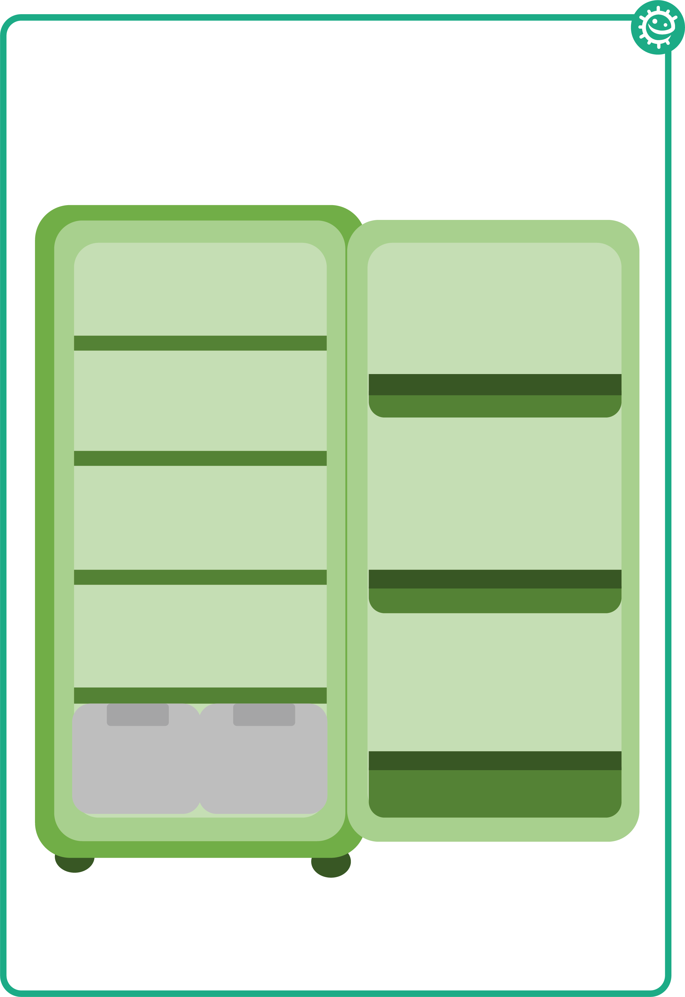
Fridge Raiders Activity – Fridge
Place the foods in the fridge on the correct shelf according to best food hygiene practices
Fridge Raiders

Slide 45
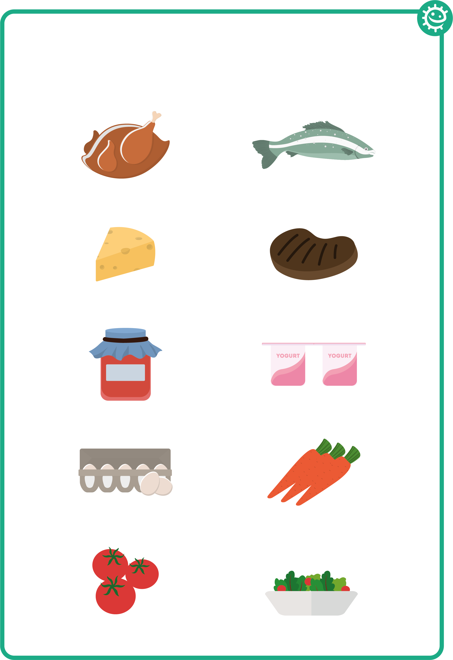
Fridge Raiders Activity – Foods
Place the foods in the fridge on the correct shelf according to best food hygiene practices
Fridge Raiders

Slide 46
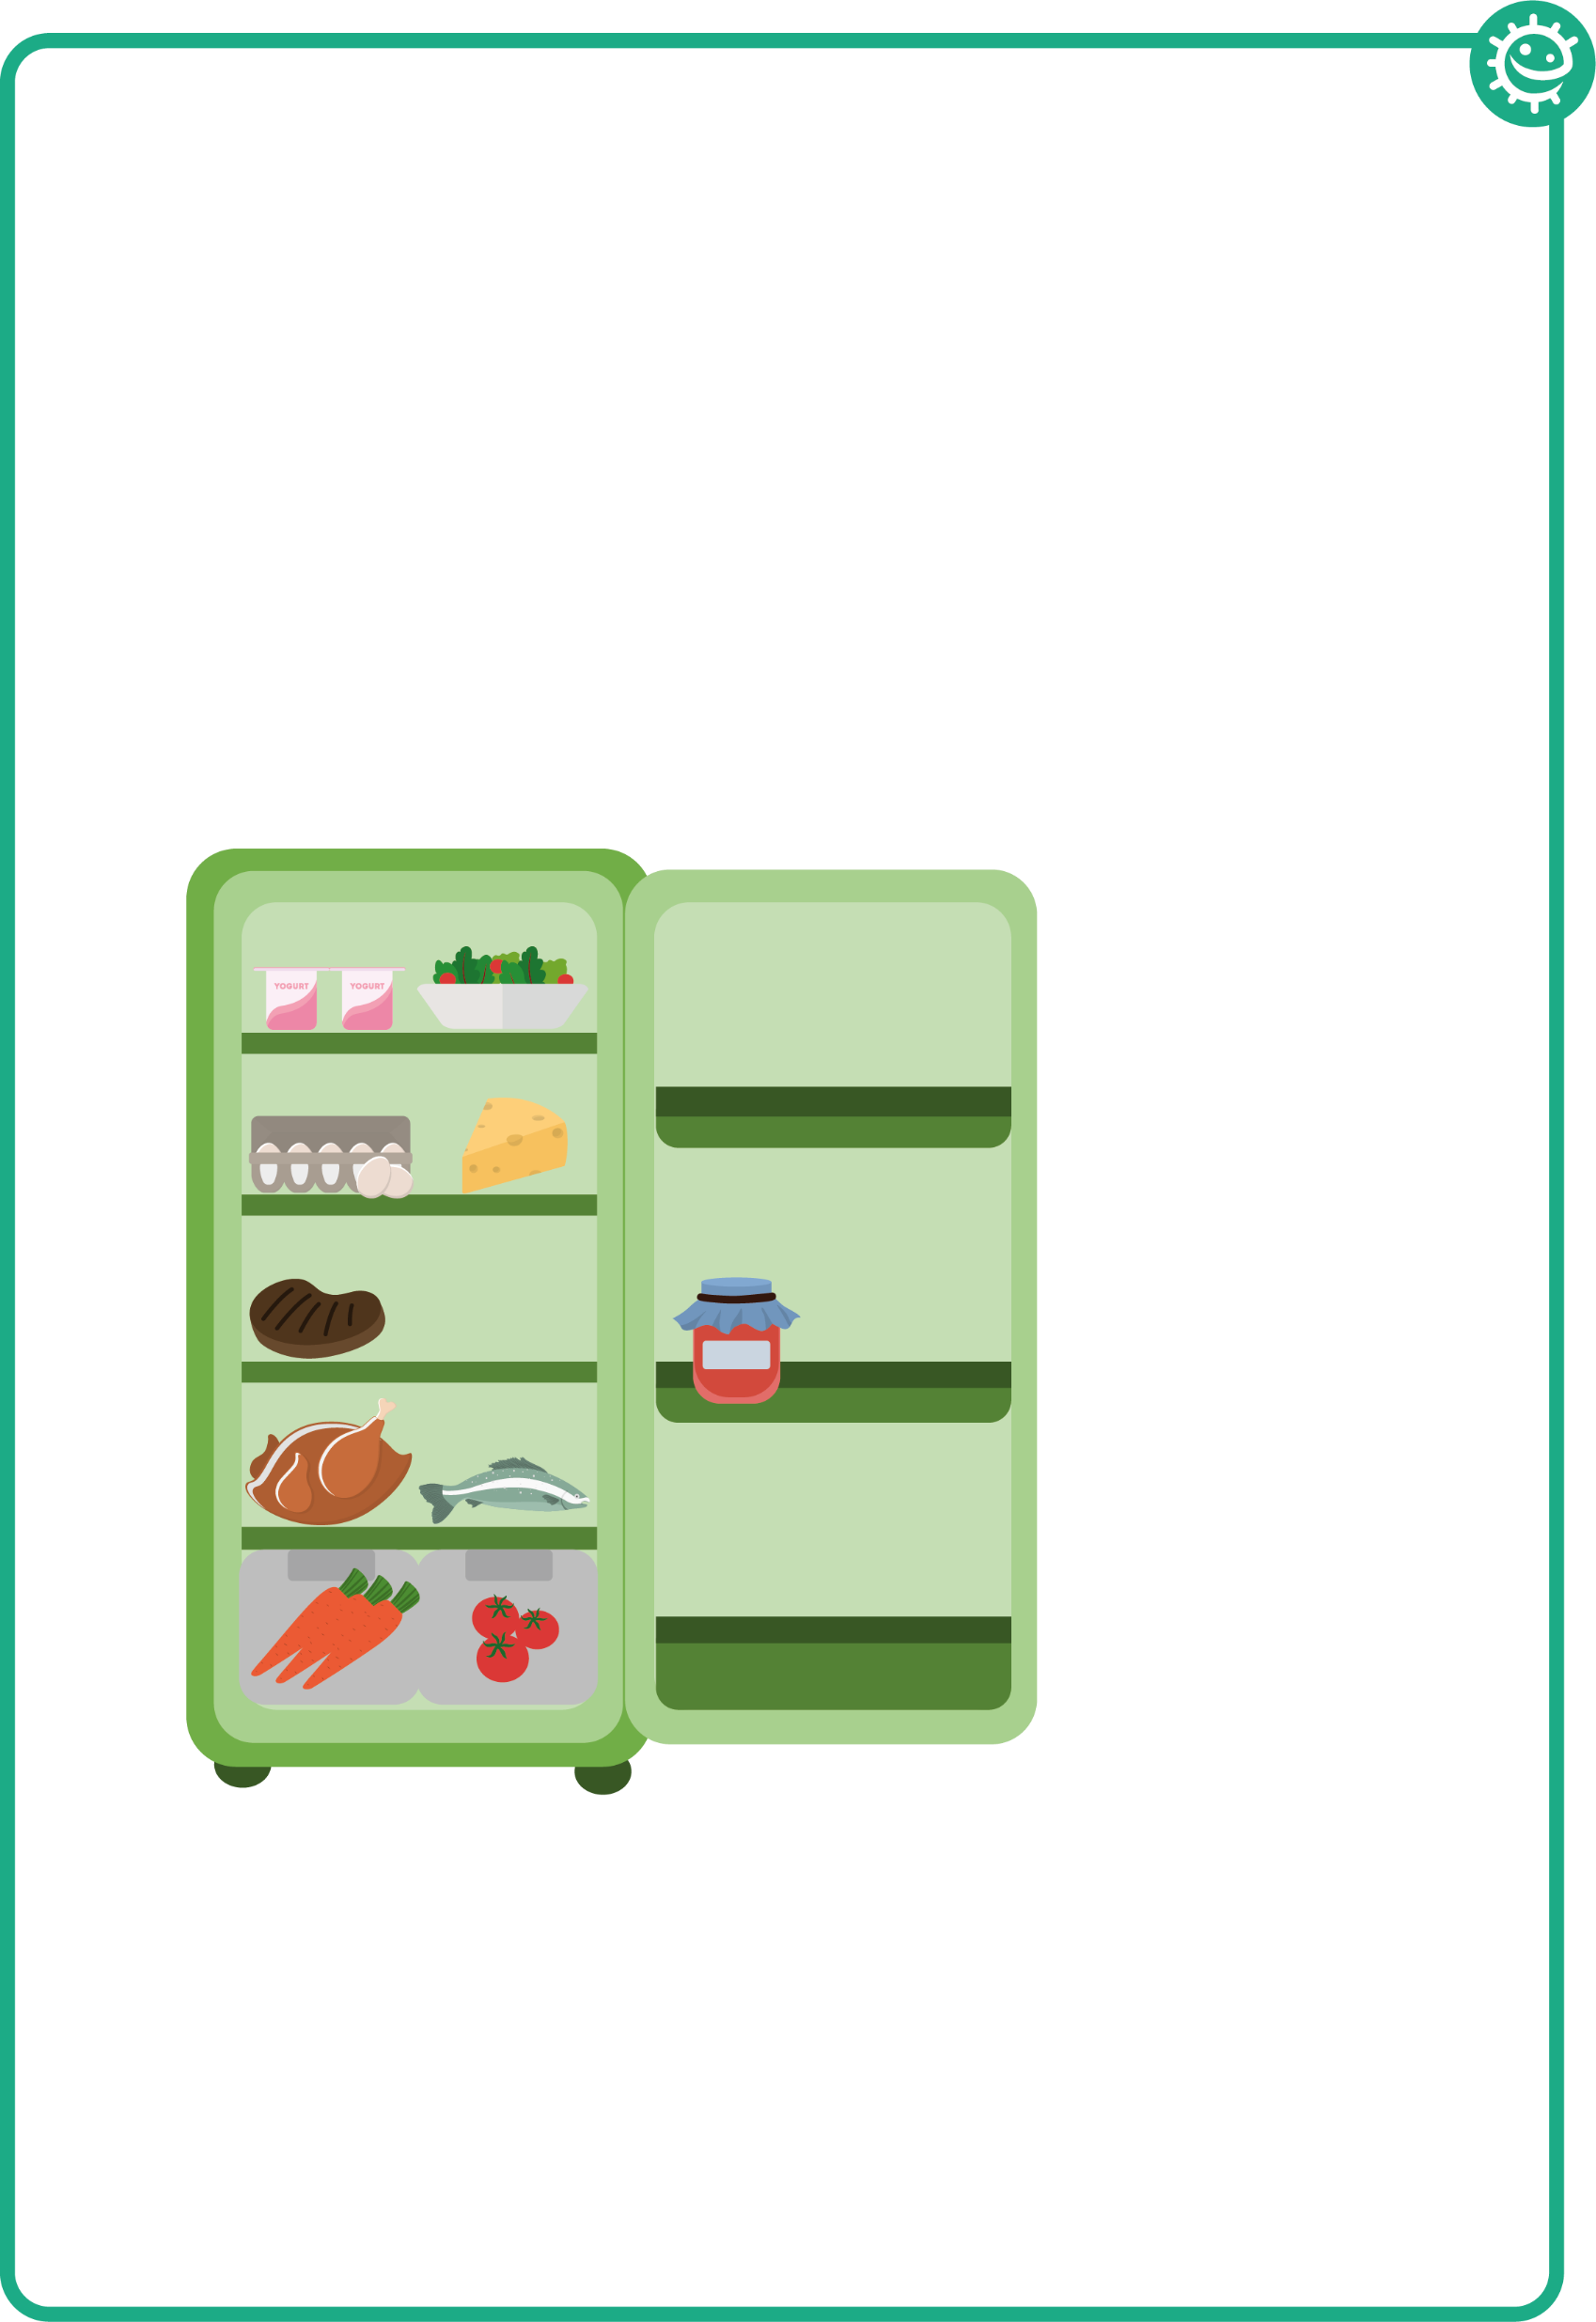
Fridge Raiders Activity – Answers
Fridge Raiders - Answers
Pre-prepared food, such as
this salad, should be covered
and kept in the fridge until use.
Cooked meat should be
covered and stored away
from raw meat.
Some jars of food,
for example jam,
need to be stored
in the fridge once
opened.
Raw meat and fish should be covered and kept on the bottom shelf in the fridge.
Store fruit and vegetables and salad in the draw at the bottom of the fridge.

Slide 47
Food Hygiene Quiz 1
Food Hygiene Quiz
Harmful microbes can commonly be found on:
(3 points)
Raw meat
Raw fish
Fruit and vegetables
Yoghurt
Meat and vegetables should be:
(1 point)
Sorted on the same shelf in the fridge
Cut on different chopping boards
Cut with the same knife
Stored in a warm cupboard

Slide 48
Food Hygiene Quiz 2
Food Hygiene Quiz
The best way to destroy harmful microbes on food is to:
(1 point)
To make sure food is cooked on the outside
Cook food as quickly as possible
Cook food thoroughly at high temperatures
To make sure food is warm before we eat it
Which food may contain useful microbes?
(3 points)
Cheese
Yoghurt
Bread
Raw chicken

Slide 49
Food Hygiene Quiz 3
Food Hygiene Quiz
Refrigeration:
(2 points)
Kills all microbes
Speeds up microbe growth
Only stops microbes growing, it doesn’t kill them
Should be set to 4°C or below
How can we prevent food poisoning?
(2 points)
Store raw meat/chicken in the fridge
Cook meat/chicken thoroughly before we eat it
By washing raw chicken
Eating yoghurt

Slide 50
Food Hygiene Quiz 4
Food Hygiene Quiz
Match the terms with their definitions:
(3 points)
Best before
The deterioration of colour, texture and flavour of food
The food is safe to eat after this date, but may no longer be at its best quality
Food is safe to eat up until this date, but should not be eaten after it
Food spoilage
Use by

Slide 51
Food Hygiene Quiz 5
Food Hygiene Quiz
Which of the following is not one of the four key ways you can prevent food poisoning?
(1 point)
Cleaning during food preparation
Cooking food thoroughly
Using the same chopping board and utensils during food preparation
Storing food correctly in refrigerators at ≤4°C
What infections can you get from poor hand washing?
(1 point)
Salmonella
Cold and flu
Diarrhoea
All of the above

Slide 52
Food Hygiene Quiz 1 - Answers
Food Hygiene Quiz - Answers
Harmful microbes can commonly be found on:
(3 points)
Raw meat
Raw fish
Fruit and vegetables
Yoghurt
Meat and vegetables should be:
(1 point)
Sorted on the same shelf in the fridge
Cut on different chopping boards
Cut with the same knife
Stored in a warm cupboard
✓
✓
✓
✓

Slide 53
Food Hygiene Quiz 2 - Answers
Food Hygiene Quiz - Answers
The best way to destroy harmful microbes on food is to:
(1 point)
To make sure food is cooked on the outside
Cook food as quickly as possible
Cook food thoroughly at high temperatures
To make sure food is warm before we eat it
Which food may contain useful microbes?
(3 points)
Cheese
Yoghurt
Bread
Raw chicken
✓
✓
✓
✓

Slide 54
Food Hygiene Quiz 3 - Answers
Food Hygiene Quiz - Answers
Refrigeration:
(2 points)
Kills all microbes
Speeds up microbe growth
Only stops microbes growing, it doesn’t kill them
Should be set to 4°C or below
How can we prevent food poisoning?
(2 points)
Store raw meat/chicken in the fridge
Cook meat/chicken thoroughly before we eat it
By washing raw chicken
Eating yoghurt
✓
✓
✓
✓

Slide 55
Food Hygiene Quiz 4 - Answers
Food Hygiene Quiz - Answers
Match the terms with their definitions:
(3 points)
Best before
The food is safe to eat after this date, but may no longer be at its best quality
The deterioration of colour, texture and flavour of food
Food is safe to eat up until this date, but should not be eaten after it
Food spoilage
Use by

Slide 56
Food Hygiene Quiz 5 - Answers
Food Hygiene Quiz - Answers
Which of the following is not one of the four key ways you can prevent food poisoning?
(1 point)
Cleaning during food preparation
Cooking food thoroughly
Using the same chopping board and utensils during food preparation
Storing food correctly in refrigerators at ≤4°C
What infections can you get from poor hand washing?
(1 point)
Salmonella
Cold and flu
Diarrhoea
All of the above
✓
✓

Slide 57
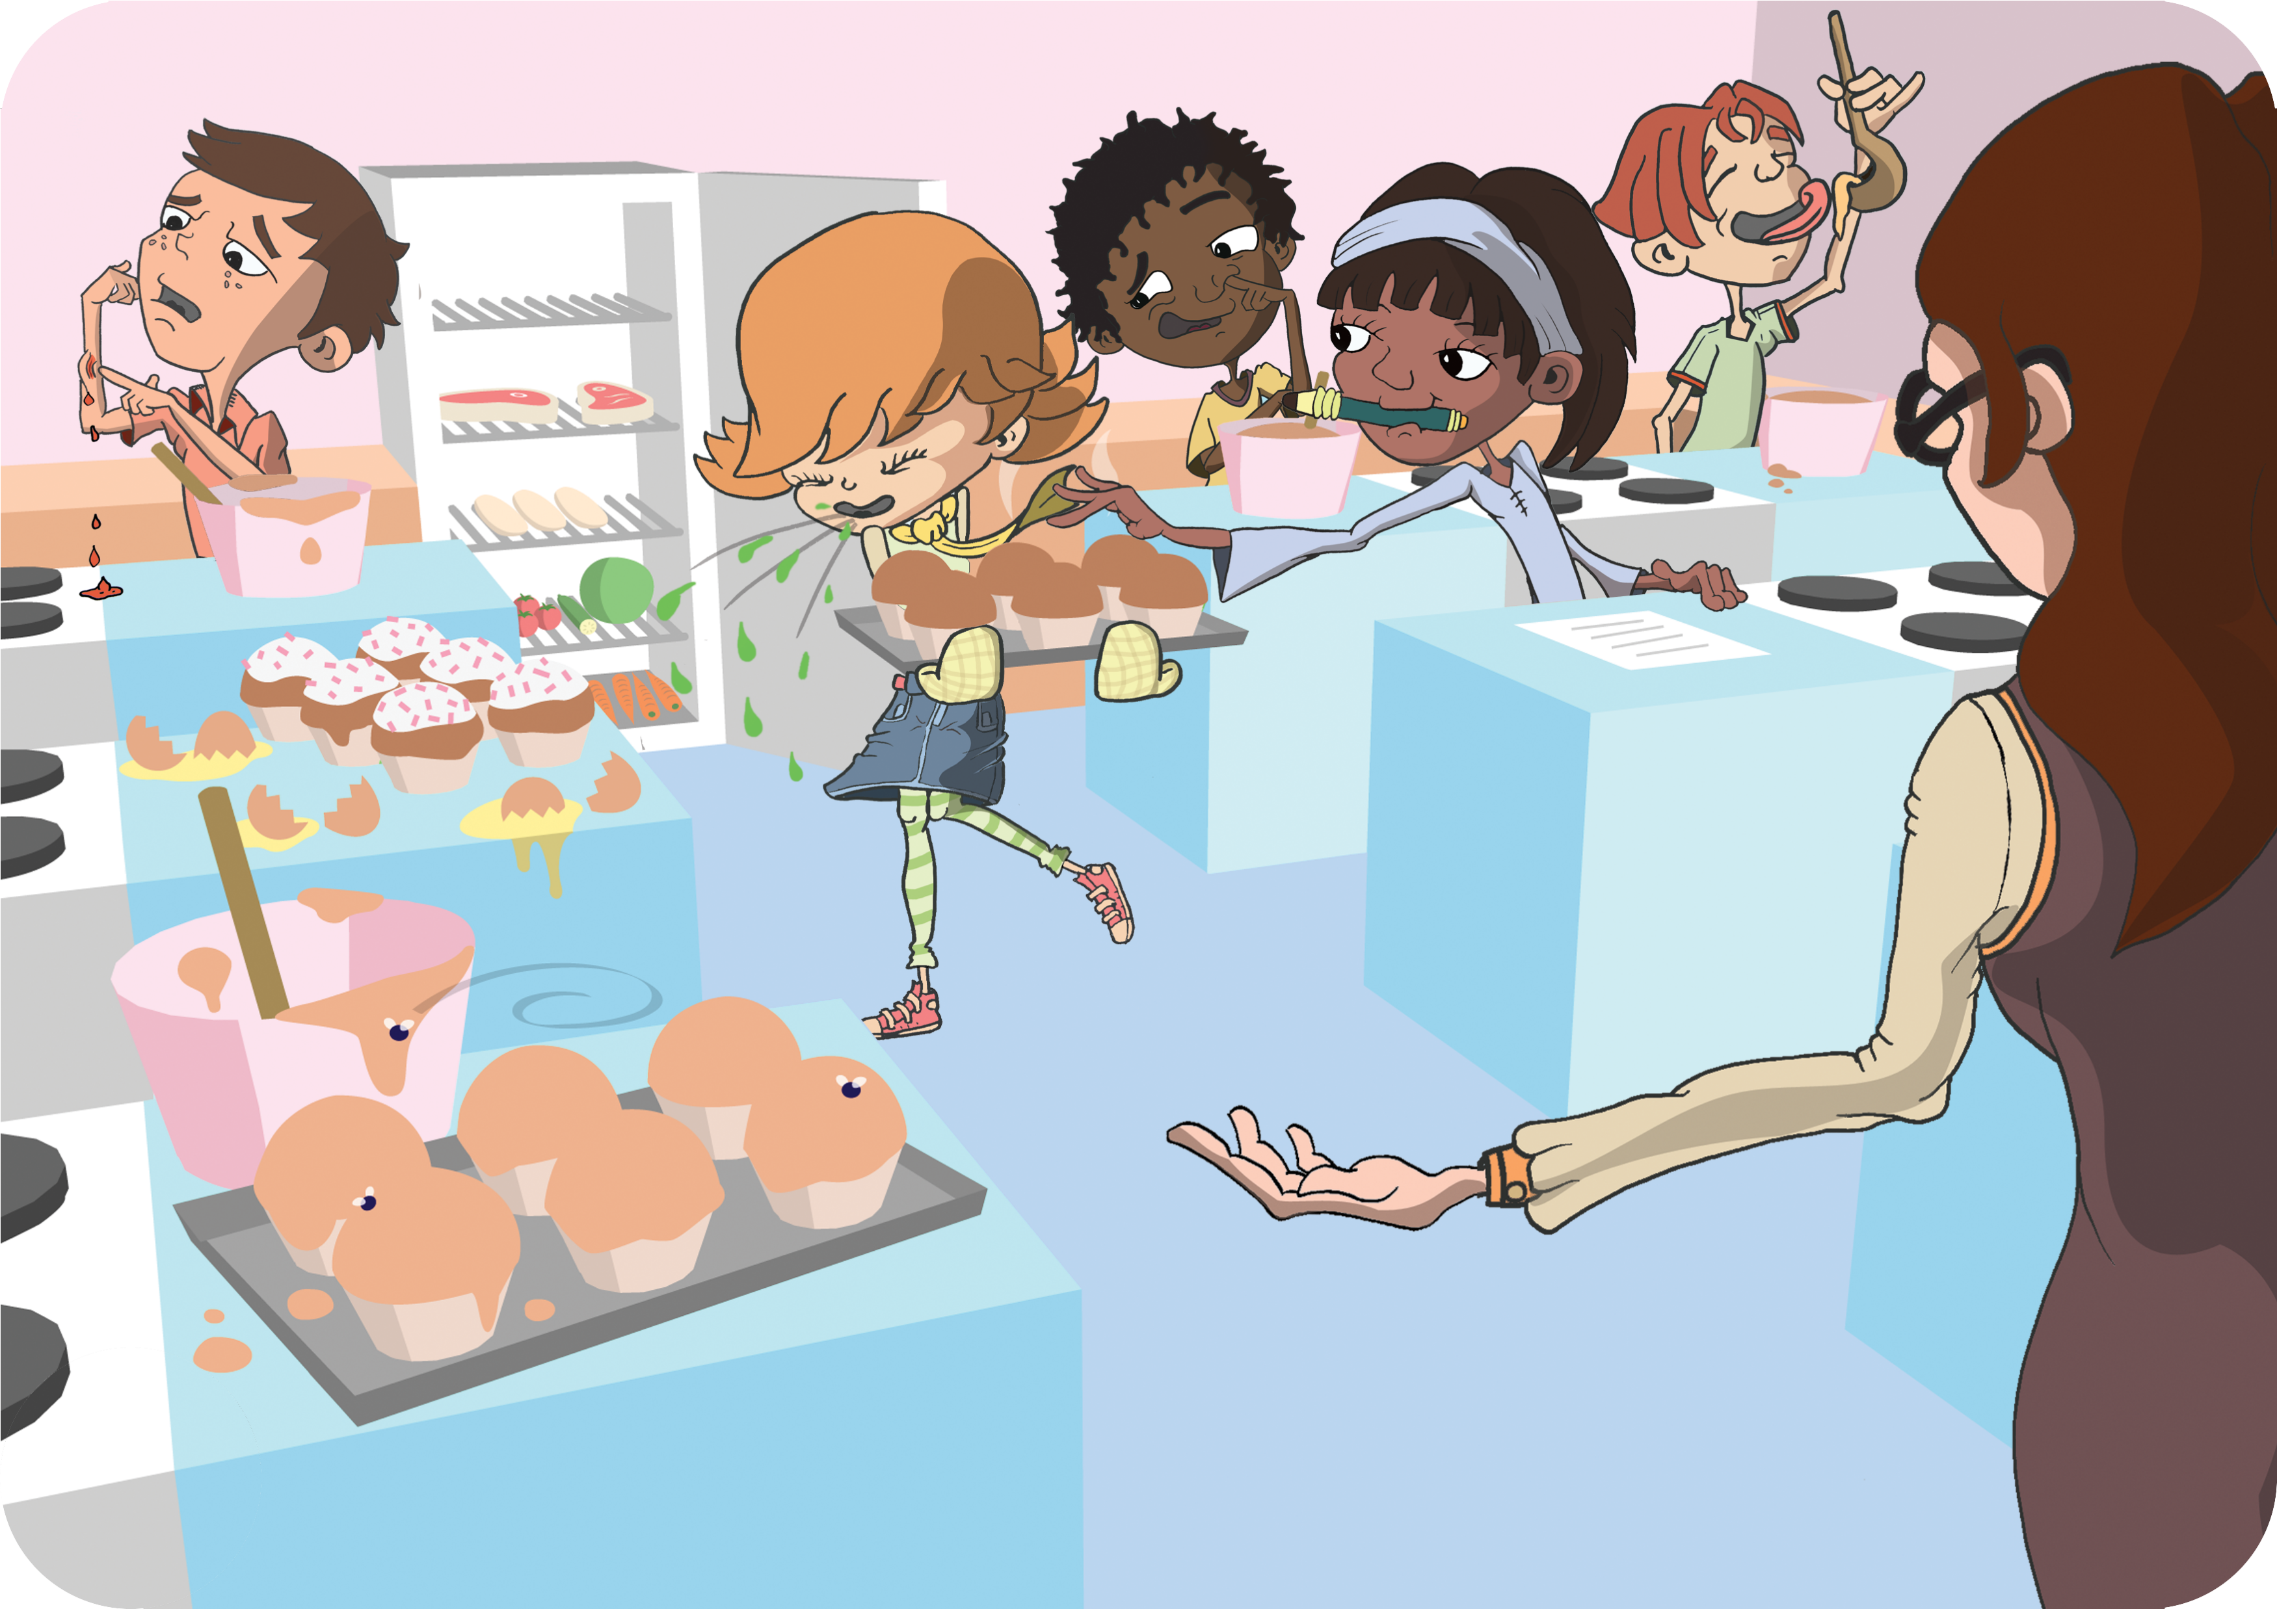
Spot the Mistakes
Spot the Mistakes. Can you circle 9 things that the students in this cookery class should not be doing and why?

Slide 58
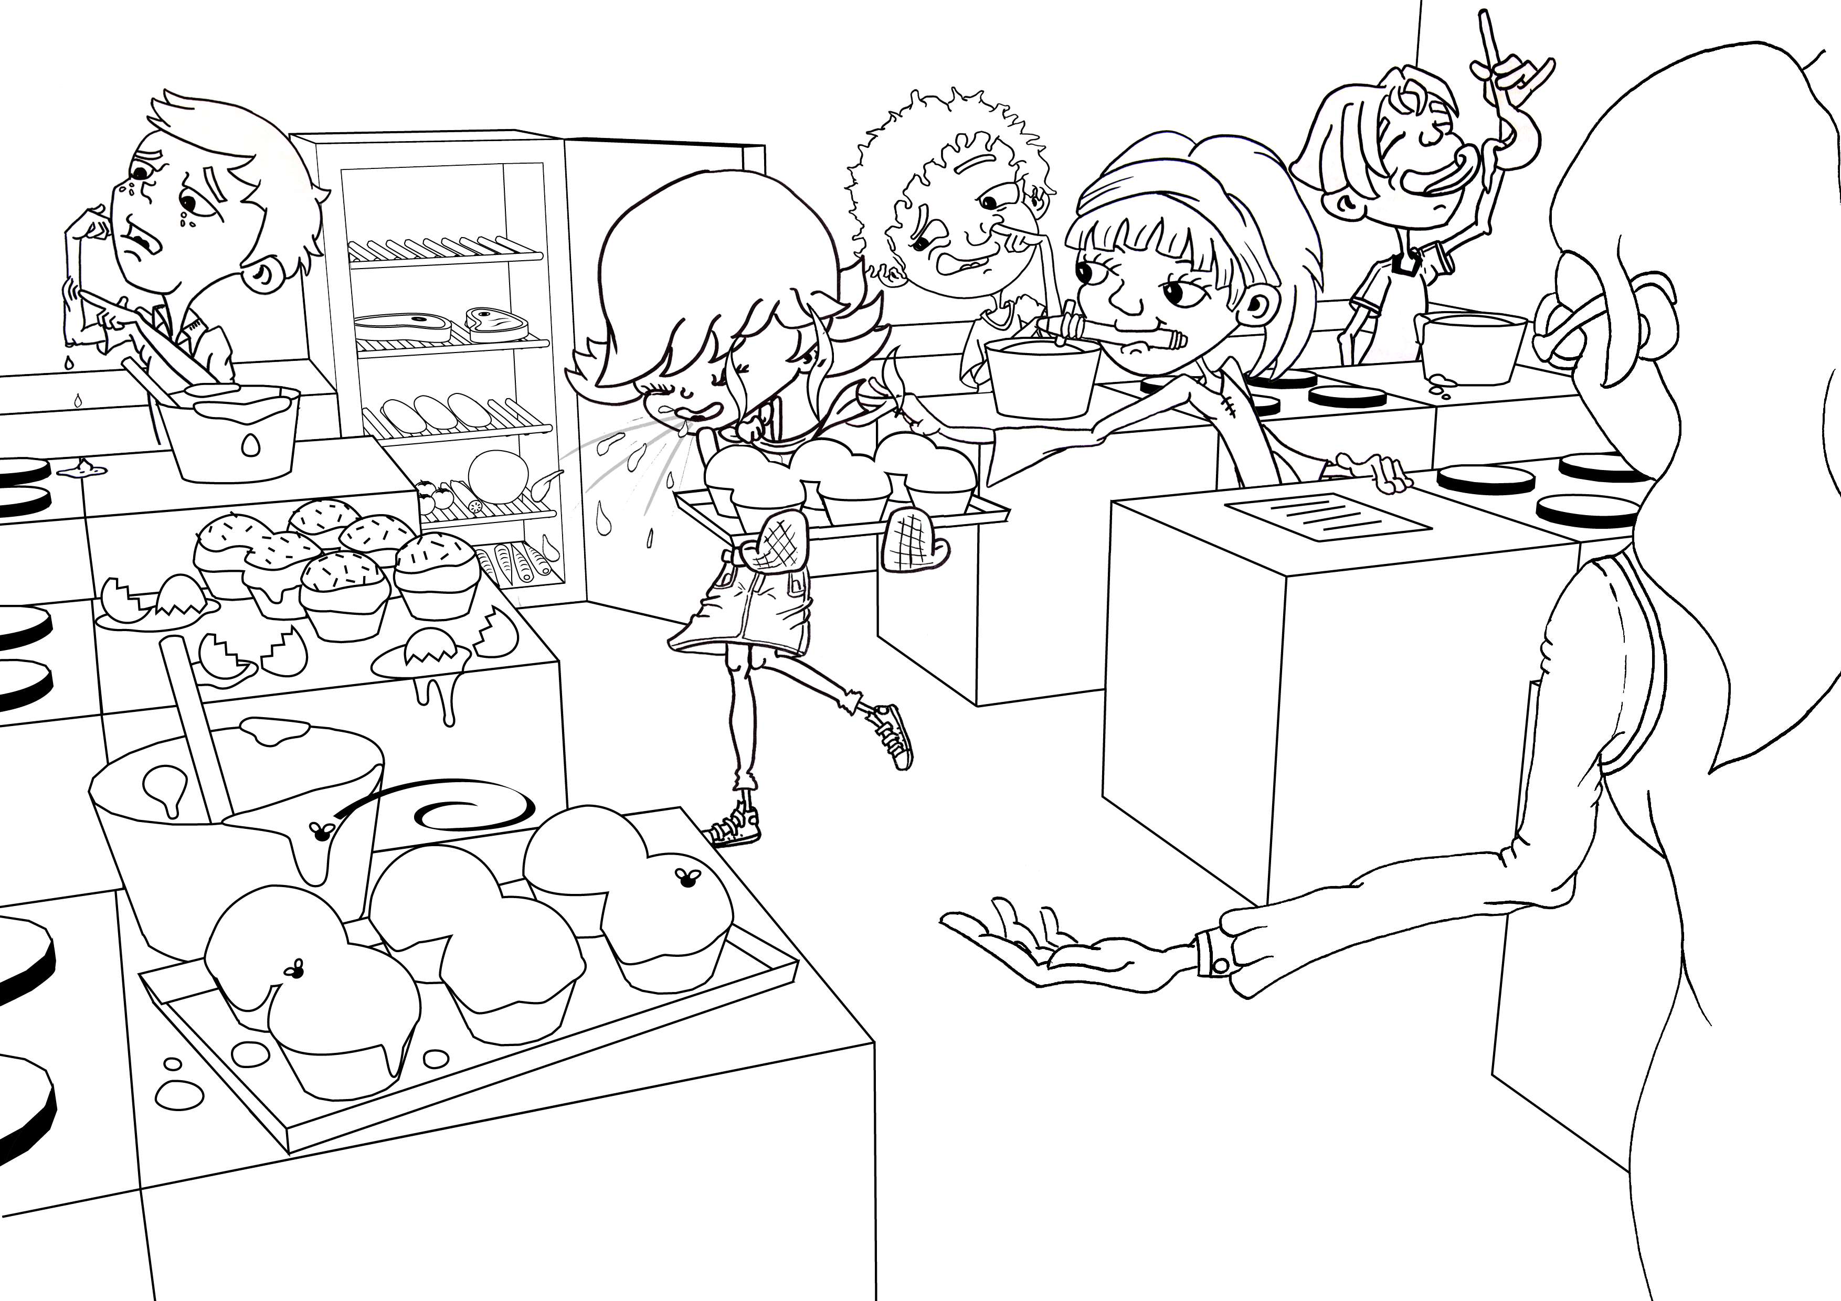
Spot the Mistakes (Black and White)
Spot the Mistakes. Can you circle 9 things that the students in this cookery class should not be doing and why?

Slide 59
Spot the Mistakes - Answers
Spot the Mistakes. Can you circle 9 things that the students in this cookery class should not be doing and why?

Slide 60
Spot the Mistakes (Black and White) - Answers
Spot the Mistakes. Can you circle 9 things that the students in this cookery class should not be doing and why?

Slide 61
Label Sort Q1
Label Sort
Match the food label to the correct definition
Best before
Display until
Consume within 3 days of opening
Keep refrigerated once opened
Use by
These dates are seen on food that goes off
quickly, such as meat products and ready
prepared salads. Don’t use any food or
drink after the end of the date on the label,
even if it looks and smells fine. Eating food
after this date could put your health at risk.
This label means that once
you have removed the
packaging and exposed
the food to the air it should
be refrigerated so to stop
microbes growing.

Slide 62
Label Sort Q2
Label Sort
Match the food label to the correct definition
Best before
Display until
Consume within 3 days of opening
Keep refrigerated once opened
Use by
These dates are about quality not safety.
This food will taste its best before the date
shown. Eating it after this date will not
mean you will get ill but the flavour might
not be as good. These dates appear on a
wide range of frozen, dried, tinned and
other foods.

Slide 63
Label Sort Q3
Label Sort
Match the food label to the correct definition
Best before
Display until
Consume within 3 days of opening
Keep refrigerated once opened
Use by
Shops often use these dates on their shelves, mainly for stock purposes. These are not required by law and are instructions for shop staff, NOT for shoppers.
This label means that food
should be eaten within the
amount of days it says on
the packaging. After this
date the food may not be
safe to eat.

Slide 64
Label Sort Q1 - Answers
Label Sort - Answers
Match the food label to the correct definition
Keep refrigerated once opened
Use by
This label means that once
you have removed the
packaging and exposed
the food to the air it should
be refrigerated so to stop
microbes growing.
These dates are seen on food that goes off
quickly, such as meat products and ready
prepared salads. Don’t use any food or
drink after the end of the date on the label,
even if it looks and smells fine. Eating food
after this date could put your health at risk.

Slide 65
Label Sort Q2 - Answers
Label Sort - Answers
Match the food label to the correct definition
Best before
These dates are about quality not safety.
This food will taste its best before the date
shown. Eating it after this date will not
mean you will get ill but the flavour might
not be as good. These dates appear on a
wide range of frozen, dried, tinned and
other foods.

Slide 66
Label Sort Q3 - Answers
Label Sort - Answers
Match the food label to the correct definition
Consume within 3 days of opening
Display until
Shops often use these dates on their shelves, mainly for stock purposes. These are not required by law and are instructions for shop staff, NOT for shoppers.
This label means that food
should be eaten within the
amount of days it says on
the packaging. After this
date the food may not be
safe to eat.

Slide 67
Learning Consolidation

Slide 68
Discussion Question
Can you name ways to reduce the spread of microbes when handling food?
• Wash my hands before and after handling food.
• Clean kitchen surfaces and utensils before and after preparing food.
• Wash fruit and vegetables before eating them.
• Don’t wash raw meat to avoid harmful microbes splashing onto other foods and surfaces.
• Don’t eat food that is past its used by date.

Slide 69
Group activity
Alternatively, pupils work in groups to create a set of rules or tips for reducing the spread of microbes in the kitchen.
Give each group a scenario, such as preparing a family dinner or packing a lunch for school.
Groups brainstorm the best practices for food hygiene, then present their rules to the class.
As a class, vote on which rules would be most effective in reducing the spread of harmful microbes.

