Slide 1
Spread of Infection: Hand Hygiene
Key Stage 2

Slide 2
Learning Intention
All pupils will:
• Understand how proper hand hygiene helps prevent the spread of infection, including when, why, and how to wash hands effectively.

Slide 3
Northern Ireland Curriculum Links
Curriculum Key Elements
Personal Health and Moral Character
Curriculum Skills
Communication, Using Mathematics, Thinking , Problem Solving and Decision Making, Being Creative, Working with Others
Curriculum Areas of Learning
Personal Development and Mutual Understanding (PDMU), The World Around Us (TWAU)

Slide 4
Why is it Important to Wash our Hands?
Importance of hand washing is to wash away any dirt or microbes that might be on our hands. If you do not wash your hands you are not washing away the microbes (you might get ill if any harmful microbes from your dirty hands gets in your mouth or an open cut, or you could pass them on to someone else).
We use our hands all the time, they are naturally covered with microbes that live in our bodies and pick up millions of microbes from the environment every day. Although many of these microbes are harmless, some could be harmful.
We spread microbes to our friends and others through touch, and this is why we wash our hands. One study found that people touch their face 23 times per hour, about 280 times a day; touch is an important sense to give information to our brain, but we should be aware of how easy it is to spread microbes when our hands are dirty.

Slide 5
Main Activity:
Healthy Hands

Slide 6

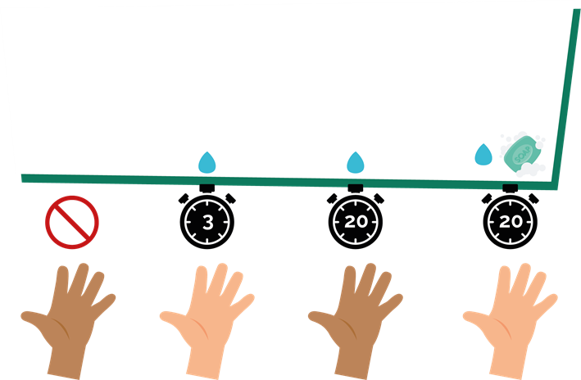
Healthy Hands Activity 1
Split into 4 groups:
a) no hand washing; washing hands in water for b) 3 and; c) 20 secs; d) washing hands with soap and water for 20 seconds
2. The person in front of each group (person one) covers their hands with UV gel or powder

Slide 7
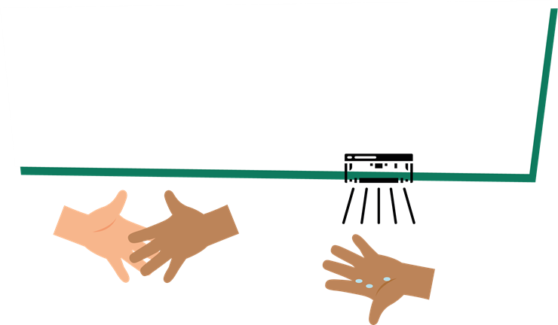
Healthy Hands Activity 2
4. Person two, shake hands with person three in your group and so on…
5. Look at your hands under the UV lamp. What do you see? How does this compare across groups?
3. Person one, shake hands with person two in your group

Slide 8
Discussion

Slide 9
Discussion Points
What can spread easily from one person to other?
What is the best way to stop harmful microbes spread?
What do you have to use when washing your hands?
What song can you sing while washing your hands?
What do we have to use if soap is not available?
What have you learnt today?
How has the activity changed the way you wash your hands?
When is it important to wash your hands?

Slide 10
Extension Activities

Slide 11

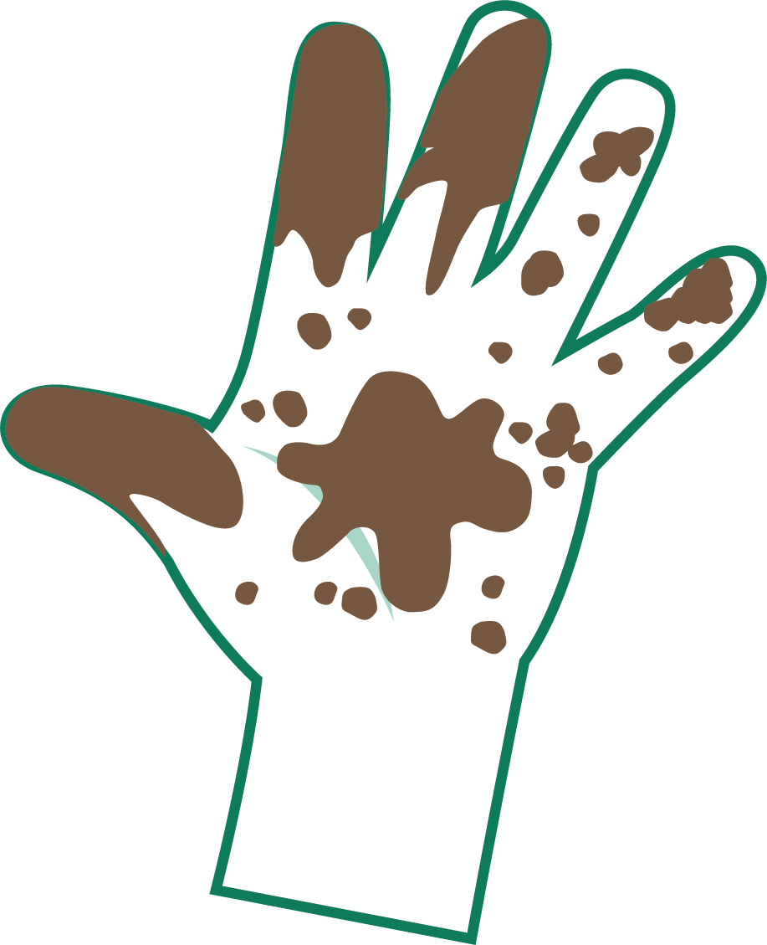
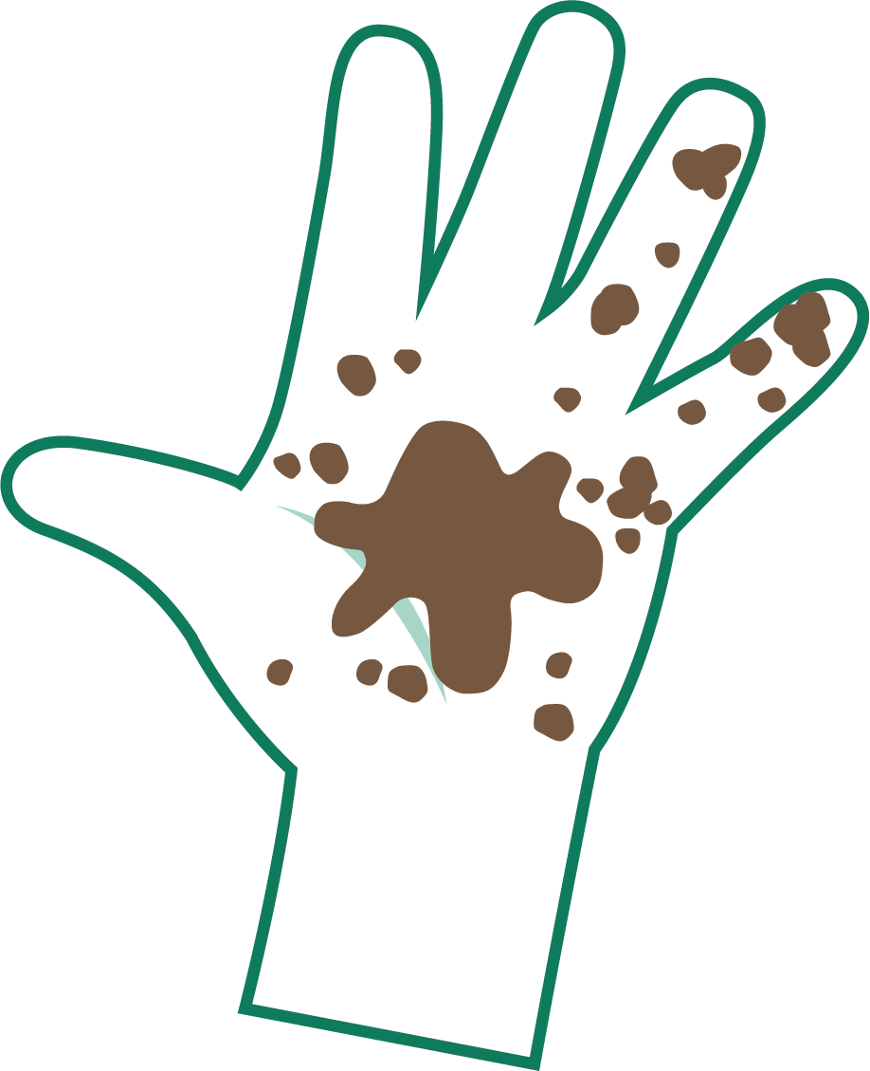
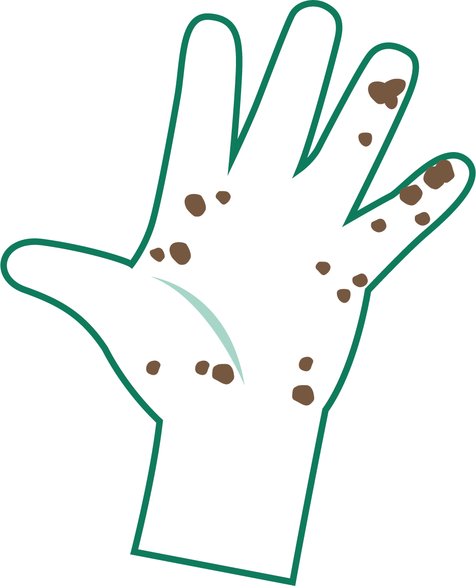

How Clean are Your Hands?
How Clean are Your Hands?
Very Dirty
Dirty
A Bit Dirty
Clean

Slide 12
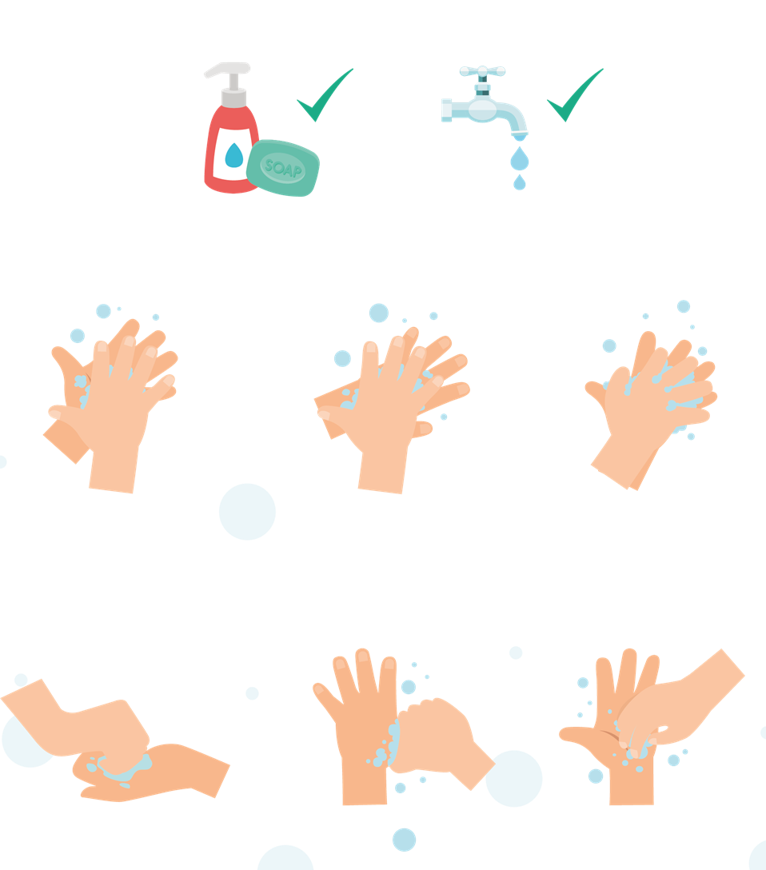
Wash Your Hands with Soap and Water for 20 Seconds
1
2
3
Palm to palm
Back of hands
Between fingers
To help keep time, sing ‘Happy Birthday’ twice
4
5
6
Back of fingers
Thumbs
Tip of fingers

Slide 13
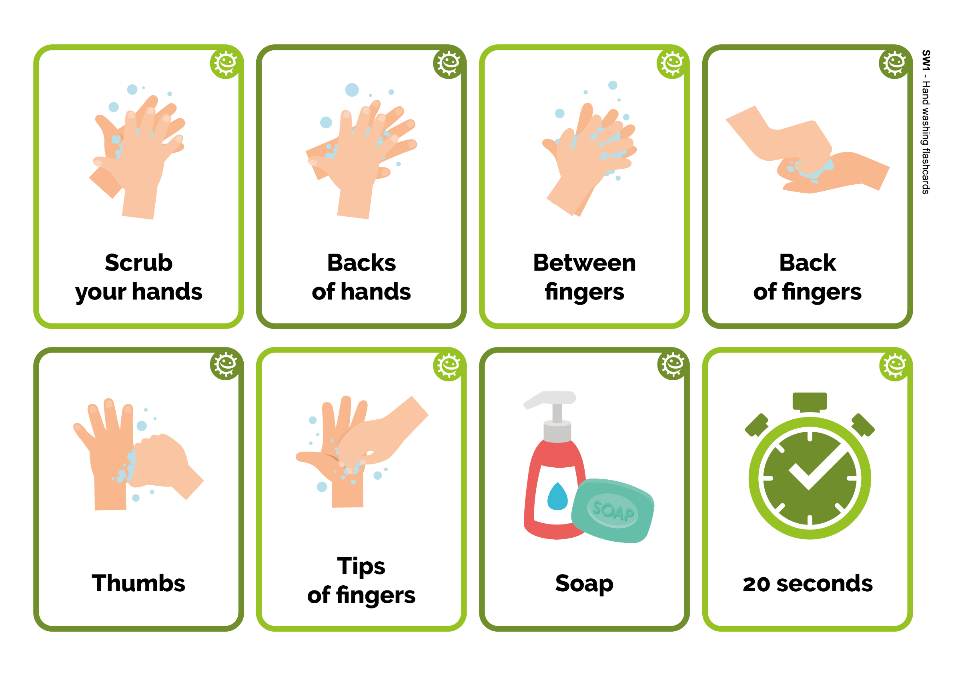
Washing Your Hands Sequencing Activity
Back
of fingers
Tips of fingers
Thumbs
Soap
Backs
of hands
Between fingers
Scrub
your hands
20 seconds

Slide 14
Washing Your Hands Sequencing Activity - Answers
Scrub
your hands
Backs
of hands
Between fingers
Back
of fingers
Thumbs
Tips of fingers
Soap
20 seconds

Slide 15

Healthy Hands Procedure 1
Healthy Hands Procedure
Student 1
Student 2
Student 3
Student 4
Student 5

Slide 16
Healthy Hands Procedure 2
Healthy Hands Procedure
After the activity, use the ‘How Clean are Your Hands?’ guide to write your results in the box provided and see how far the microbes have spread.
After washing (or not) and shaking hands
 | Student 1 | Student 2 | Student 3 | Student 4 | Student 5
No wash (control)
Wash for 3 secs
Wash for 20 secs
Wash with soap and water for 20 secs

Slide 17
Healthy Hands Procedure 3
Healthy Hands Procedure
On the next page draw where you saw microbes after hand washing and shaking, for your group only.
The method of hand washing that removed most microbes from the lead person was:
Wash for 3 seconds
Wash for 20 seconds
Wash for 20 seconds with soap & water
The method of hand washing that removed fewest microbes from the lead person was:
Wash for 3 secs
Wash for 20 secs
Wash for 20 secs with soap & water
The method of hand washing which spread the most microbes along the line was:
Wash for 3 secs
Wash for 20 secs
Wash for 20 secs with soap & water
The method of hand washing which removed the fewest microbes along the line was?
Draw a graph of how far the microbes spread for all four groups (including control).

Slide 18
Healthy Hands Procedure 4
Healthy Hands Procedure
My conclusions:
What is the best way of getting rid of microbes from our hands?
_________________________________________
What difference does using soap make?
_________________________________________
When should we wash our hands?
_________________________________________
Fascinating Fact
90% of germs on the hand are found under the nails!

Slide 19
Healthy Hands Procedure 1 - Answers
Healthy Hands Procedure - Answers
After the activity, use the ‘How Clean are Your Hands?’ guide to write your results in the box provided and see how far the microbes have spread.
After washing (or not) and shaking hands
 | Student 1 | Student 2 | Student 3 | Student 4 | Student 5
No wash (control)
Wash for 3 secs
Wash for 20 secs
Wash with soap and water for 20 secs
Your Findings

Slide 20
Healthy Hands Procedure 2 - Answers
Healthy Hands Procedure - Answers
On the next page draw where you saw microbes after hand washing and shaking, for your group only.
The method of hand washing that removed most microbes from the lead person was:
Wash for 3 seconds
Wash for 20 seconds
Wash for 20 seconds with soap & water
The method of hand washing that removed fewest microbes from the lead person was:
Wash for 3 secs
Wash for 20 secs
Wash for 20 secs with soap & water
The method of hand washing which spread the most microbes along the line was:
Wash for 3 secs
Wash for 20 secs
Wash for 20 secs with soap & water
The method of hand washing which removed the fewest microbes along the line was?
Draw a graph of how far the microbes spread for all four groups (including control).
✓
✓
✓
Washing hands for 3 seconds

Slide 21
Healthy Hands Procedure 3 - Answers
Healthy Hands Procedure - Answers
My conclusions:
What is the best way of getting rid of microbes from our hands?
What difference does using soap make?
When should we wash our hands?
Wash your hands with antimicrobial soap and water for at least 20 seconds, following the six steps for handwashing.
Soap breaks down the oils, which microbes stick to, on our hands.
Key moments:
Before, during and after preparing food; Before eating or handling ready to eat food; After using the toilet or changing a soiled nappy/underwear; After exposure to animals or animal waste; After coughing, sneezing, or blowing your nose; If you are ill or have been around ill people.
Fascinating Fact
90% of germs on the hand are found under the nails!

Slide 22


Hand Hygiene Fill in the Blanks Worksheet
Our hands are naturally covered with _ _ _ _ _ _ _ _ that live on our
bodies and pick up millions more from our environment everyday.
Microbes can _ _ _ _ _ _ easily from child to child when we touch each other.
Although some microbes can be useful, others can be harmful and cause _ _ _ _ _ _ _ _ _.
_ _ _ _ _ _ _ _ _ _ _ is the most effective way of reducing and preventing the spread of infection.
Washing our hands with _ _ _ _ and water at key moments removes any harmful microbes we pick up on our hands from our surroundings.
We should wash our hands for _ _ _ _ _ _ _ _ _ , which is the length of the happy birthday song twice.
Washing hands in water alone will only remove _ _ _ _ and
grime.
If soap is unavailable, we should use _ _ _ _ _ _ _ _ _ _ _ as long as there is no visible dirt/other substance on hands.
Key words:
Hand sanitiser, Microbes, Dirt, Infection, Soap, Hand washing,
Spread, 20 seconds

Slide 23
Hand Hygiene Fill in the Blanks - Answers
microbes
Our hands are naturally covered with _ _ _ _ _ _ _ _ that live on our bodies and pick up millions more from our environment everyday.
Microbes can _ _ _ _ _ _ easily from child to child when we touch each other.
Although some microbes can be useful, others can be harmful and cause _ _ _ _ _ _ _ _ _.
_ _ _ _ _ _ _ _ _ _ _ is the most effective way of reducing and preventing the spread of infection.
Washing our hands with _ _ _ _ _ _ _ _ _ _ _ _ _ _ _ _ _ _ _
and water at key moments removes any harmful microbes we pick up on our hands from our surroundings.
We should wash our hands for _ _ _ _ _ _ _ _ _ , which is the length of the happy birthday song twice.
Washing hands in water alone will only remove _ _ _ _ and
grime.
If soap is unavailable, we should use _ _ _ _ _ _ _ _ _ _ _ as long as there is no visible dirt/other substance on hands.
transfer
infection
Hand washing
soap
20 seconds
Key words:
Hand sanitiser, Microbes, Dirt, Infection, Soap, Hand washing,
Spread, 20 seconds
dirt
hand sanitiser

Slide 24
Hand Hygiene Quiz 1
Hand Hygiene Quiz
How can you spread microbes to others?
(2 points)
By touching them
By looking at them
By speaking to them on the phone
By sneezing
Why should we use soap to wash our hands?
(2 points)
It helps remove invisible microbes too small to be seen by our eyes
It breaks up the oil on our hands which trap microbes
It keeps our hands moist
It doesn’t matter if we use soap or not

Slide 25
Hand Hygiene Quiz 2
Hand Hygiene Quiz
Which is NOT one of the 6 steps of hand washing?
(1 point)
Palm to palm
The thumbs
Arms
In between fingers
Who might be at risk as a result of you not washing your hands properly?
(1 point)
You
Your family
Your friends
All of the above

Slide 26
Hand Hygiene Quiz 3
Hand Hygiene Quiz
How can you stop harmful microbes from spreading?
(2 points)
Do nothing
Wash hands in water
Use hand sanitiser if soap and water are not available
Wash your hands with running water and soap
When should we wash our hands?
(3 points)
After stroking a pet
After sneezing or coughing
After watching TV
After using the bathroom or changing a soiled nappy

Slide 27
Hand Hygiene Quiz 4
Hand Hygiene Quiz
After we sneeze into our tissue, we should:
(2 points)
Wash our hands immediately
Dry our hands on our clothes
Take antibiotics
Put the tissue straight into the bin
How long should we wash our hands for?
(1 point)
10 seconds
20 seconds (length of Happy birthday song twice)
1 minute
5 minutes

Slide 28
Hand Hygiene Quiz 1 - Answers
Hand Hygiene Quiz - Answers
Why should we use soap to wash our hands?
(2 points)
It helps remove invisible microbes too small to be seen by our eyes
It breaks up the oil on our hands which trap microbes
It keeps our hands moist
It doesn’t matter if we use soap or not
How can you spread microbes to others? (2 points)
By touching them
By looking at them
By speaking to them on the phone
By sneezing
✓
✓
✓
✓

Slide 29
Hand Hygiene Quiz 2 - Answers
Hand Hygiene Quiz - Answers
Which is NOT one of the 6 steps of hand washing?
(1 point)
Palm to palm
The thumbs
Arms
In between fingers
Who might be at risk as a result of you not washing your hands properly?
(1 point)
You
Your family
Your friends
All of the above
✓
✓

Slide 30
Hand Hygiene Quiz 3 - Answers
Hand Hygiene Quiz - Answers
How can you stop harmful microbes from spreading?
(2 points)
Do nothing
Wash hands in water
Use hand sanitiser if soap and water are not available
Wash your hands with running water and soap
When should we wash our hands?
(3 points)
After stroking a pet
After sneezing or coughing
After watching TV
After using the bathroom or changing a soiled nappy
✓
✓
✓
✓
✓

Slide 31
Hand Hygiene Quiz 4 - Answers
Hand Hygiene Quiz - Answers
After we sneeze into our tissue, we should:
(2 points)
Wash our hands immediately
Dry our hands on our clothes
Take antibiotics
Put the tissue straight into the bin
How long should we wash our hands for?
(1 point)
10 seconds
20 seconds (length of Happy birthday song twice)
1 minute
5 minutes
✓
✓
✓

Slide 32
Learning Consolidation

Slide 33
Discussion Question 1
What song will you choose to use when washing your hands? How many steps are there to wash every part of your hands?
‘Happy Birthday’ song (twice)
6 Steps

Slide 34
Discussion Question 2
What are the key moments in the day that you must wash your hands?
Before eating
After using the toilet
After touching animals
After coughing, sneezing or blowing your nose
If you are ill or have been around ill people
When you get home or go into another place like school

Slide 35
Discussion Question 3
What can you use if you are not able to wash your hands with soap and water?
Hand sanitiser

