Slide 1
Spread of Infection:
Respiratory Hygiene
Key Stage 2

Slide 2
Learning Intention
All pupils will:
• Understand how infections can be spread through coughs and sneezes and how practising proper hygiene can help prevent their transmission.

Slide 3
Northern Ireland Curriculum Links
Curriculum Key Elements
Personal Health and Moral Character
Curriculum Skills
Communication, Using Mathematics, Thinking, Problem Solving and Decision Making
Curriculum Areas of Learning
Personal Development and Mutual Understanding (PDMU), The World Around Us (TWAU)

Slide 4
How Can Microbes be Passed From Person to Person? (1/2)
How Can Microbes be Passed From Person to Person?
Germs (microbes) can be passed from person to person through coughing and sneezing.
Although infections can spread from person to person, there are usually a few different ways that we could have been exposed to the germs that caused it.
It is usually impossible to know who we caught the infection from and it is important that we all take responsibility for preventing the spread of these germs by properly covering coughs/sneezes, good hand washing and not touching our eyes and face with unwashed hands.

Slide 5
How Can Microbes be Passed From Person to Person? (2/2)
How Can Microbes be Passed From Person to Person?
Germs that cause some diseases are so small that they can travel through the air in water droplets when people cough or sneeze.
Diseases spread in this way range from the common cold to rarer or more serious infections such as tuberculosis (TB).
Cold and flu, are caused by viruses and not bacteria. It is very important for everyone’s health that people cover their mouth and nose with a tissue when they cough and sneeze, or to sneeze into the crook of their elbow if they do not have a tissue. The spread of infection can be reduced through good respiratory hygiene.

Slide 6
Main Activity:
Super Sneeze

Slide 7

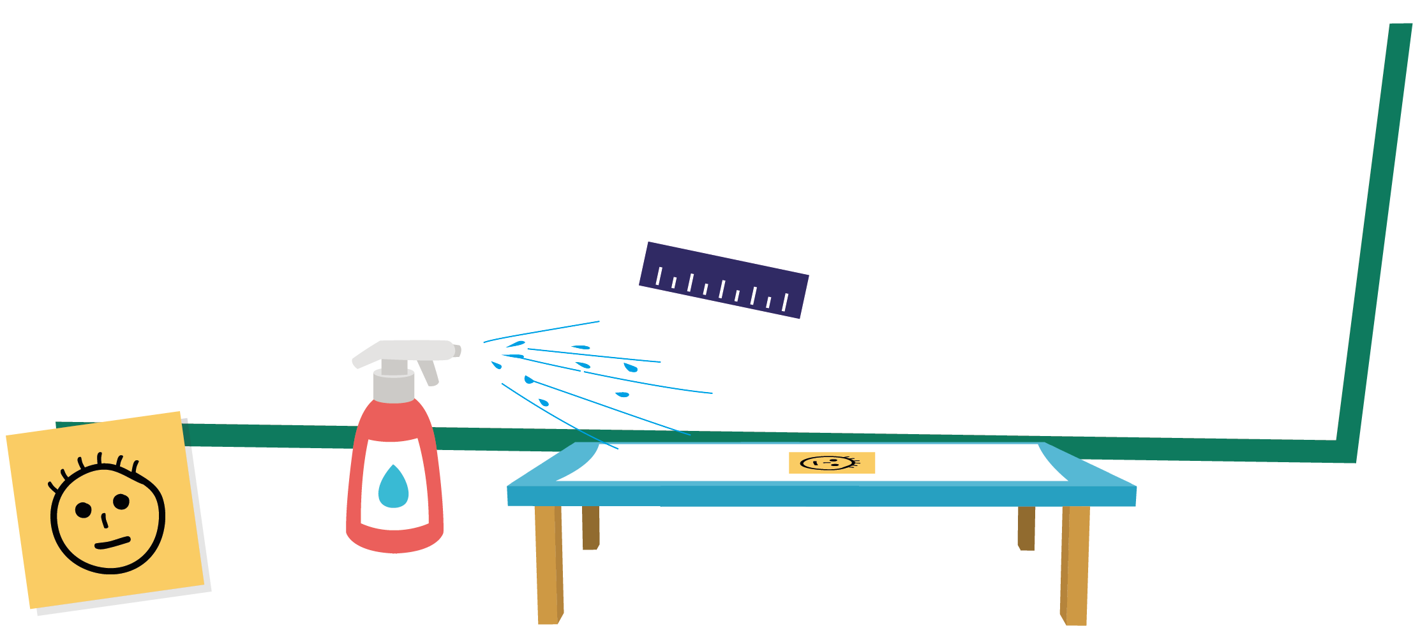
Super Sneeze Activity
1. Write your name on a sticky note and place on runway
2. Spray the bottle from the end of runway
3. Measure the distance
4. Spray the bottle with hand of glove over nozzle
5. Spray the bottle with kitchen towel over the nozzle

Slide 8
Discussion

Slide 9
Discussion Points
What is the outcome of their results?
Why you may want to sneeze into the crook of your elbow or sleeve if no tissue is available?
If sneezing in your hand what can spread to things that we touch?
What do we do next when we sneeze/cough?
If we do not have a tissue how do we sneeze/cough?

Slide 10
Extension Activities

Slide 11


Super Sneezes - Observations
Super Sneezes
My Observations
How far did your sneeze travel
 |  | Student 1 | Student 2 | Student 3 | Student 4 | Student 5
Sneeze | Length (cm)
 | Width (cm)
Sneeze with hand | Length (cm)
 | Width (cm)
Sneeze with tissue | Length (cm)
 | Width (cm)

Slide 12
Super Sneezes - Questions
Super Sneezes
What do you think will happen when you put the hand over the mouth to sneeze? Make a prediction.
_____________________________________________________________
What do you think will happen when you put the tissue over the mouth to sneeze? Make a prediction.
_____________________________________________________________
What actually happened when the hand was over the mouth to sneeze? (Where and how far did the sneeze travel?) ______________________________________________________________
What actually happened when the tissue was over the mouth to sneeze? (Where and how far did the sneeze travel?) ______________________________________________________________

Slide 13
Super Sneezes - Conclusions
Super Sneezes
My Conclusions
Why is hand hygiene important after coughing and sneezing?
___________________________________________________________________________________________________________________________________________________
What can we do to stop germs spreading from person to person?
_____________________________________________________________________________________________________________________________________________________________________________________________________________________________________________________

Slide 14
Super Sneezes Observations – Answers
Super Sneezes - Answers
My Observations
How far did your sneeze travel
 |  | Student 1 | Student 2 | Student 3 | Student 4 | Student 5
Sneeze | Length (cm)
 | Width (cm)
Sneeze with hand | Length (cm)
 | Width (cm)
Sneeze with tissue | Length (cm)
 | Width (cm)
Your Observations

Slide 15
Super Sneezes Questions – Answers
Super Sneezes - Answers
What do you think will happen when you put the hand over the mouth to sneeze? Make a prediction.
__________________________________________________________________________________________________________________________
What do you think will happen when you put the tissue over the mouth to sneeze? Make a prediction.
__________________________________________________________________________________________________________________________
The sneeze travelled less far than when uncovered and reached fewer people.
The sneeze travelled less far than when uncovered or cover by hand and reached fewer people.
What actually happened when the hand was over the mouth to sneeze? (Where and how far did the sneeze travel?) __________________________________________________________________________________________________________________________________________________________________________________________
What actually happened when the tissue was over the mouth to sneeze? (Where and how far did the sneeze travel?) __________________________________________________________________________________________________________________________________________________________________________________________
The sneeze was mainly contained by the hand, which is now contaminated. The sneeze travelled less far than when uncovered and reached fewer people.
The sneeze was contained by the tissue. The sneeze travelled less far than when uncovered or covered by the hand and reached fewer people. The hand holding the tissue is contaminated.

Slide 16
Super Sneezes Conclusions – Answers
Super Sneezes - Answers
My Conclusions
Why is hand hygiene important after coughing and sneezing?
____________________________________________________________________________________________________________________________________________________________________________________________________
What can we do to stop germs spreading from person to person?
_____________________________________________________________________________________________________________________________________________________________________________________________________________________________________________________
When covering sneezes with hands or tissues the hands are exposed to numerous microbes. If left unwashed, these potentially contagious microbes can be transmitted to other people through touch.
Cover coughs and sneezes, preferably with a tissue, and bin the tissue and wash hands with antimicrobial soap and water immediately.
If a tissue is unavailable, sneezes should be covered by the crook of the elbow or sleeve.

Slide 17
Respiratory Hygiene Quiz 1
Respiratory Hygiene Quiz
After we sneeze into our hands, we should:
(2 points)
Wash our hands
Dry our hands on our clothes
Take antibiotics
None of the above is necessary
How can you spread microbes to others?
(3 points)
Touching
Sleeping
Sneezing
Coughing

Slide 18
Respiratory Hygiene Quiz 2
Respiratory Hygiene Quiz
If you do not have a tissue available, the best option from the following is to sneeze:
(1 point)
Into your hands
Into your sleeve
Into an empty space
Onto your desk
The best way to stop microbes from spreading is: (2 points)
To use your hand to cover your sneeze
To use a tissue to cover your sneeze
To use a sleeve if you haven’t got a tissue
To drink plenty of fluids

Slide 19
Respiratory Hygiene Quiz 3
Respiratory Hygiene Quiz
What should you do with a tissue after sneezing into it?
(1 point)
Put it in your pocket for next time
Put it straight in the bin
Put it up your sleeve for next time
Any of the above
What might happen if we don’t wash our hands after sneezing into them?
(1 point)
Nothing
Transfer harmful microbes to other people
Help protect our microbes

Slide 20
Respiratory Hygiene Quiz 1 - Answers
Respiratory Hygiene Quiz - Answers
After we sneeze into our hands, we should:
(1 points)
Wash our hands
Dry our hands on our clothes
Take antibiotics
None of the above is necessary
How can you spread microbes to others?
(3 points)
Touching
Sleeping
Sneezing
Coughing
✓
✓
✓
✓

Slide 21
Respiratory Hygiene Quiz 2 - Answers
Respiratory Hygiene Quiz - Answers
If you do not have a tissue available, the best option from the following is to sneeze:
(1 point)
Into your hands
Into your sleeve
Into an empty space
Onto your desk
The best way to stop microbes from spreading is: (2 points)
To use your hand to cover your sneeze
To use a tissue to cover your sneeze
To use a sleeve if you haven’t got a tissue
To drink plenty of fluids
✓
✓
✓

Slide 22
Respiratory Hygiene Quiz 3 - Answers
Respiratory Hygiene Quiz - Answers
What should you do with a tissue after sneezing into it?
(1 point)
Put it in your pocket for next time
Put it straight in the bin
Put it up your sleeve for next time
Any of the above
What might happen if we don’t wash our hands after sneezing into them?
(1 point)
Nothing
Transfer harmful microbes to other people
Help protect our microbes
✓
✓

Slide 23
Respiratory Hygiene Fill in the Blanks
_______________ can spread from person to person through the air, through person-to-person contact (touching hands, hugging,
kissing) or by touching contaminated surfaces.
Colds and flus are the most common type of infection in the
classroom and among the most _______________.
Common _______________ of a respiratory infection can include
_______________, sore throat, _______________, and sometimes a runny or blocked nose.
We can prevent microbes being transmitted from person to person
by covering our _______________ and _______________ with a tissue and throwing away the tissue immediately.
We should always wash our hands with soap and water, or
_______________ if soap and water are not available, immediately
after throwing away the tissue.
Although there are many _______________ microbes that can make us ill, we can prevent some infections by getting _______________.
Key words:
headaches, hand sanitiser, fever, vaccinations, symptoms, microbes, sneezes, coughs, harmful, contagious

Slide 24
Respiratory Hygiene Fill in the Blanks - Answers
Infections
_______________ can spread from person to person through the air, through person-to-person contact (touching hands, hugging,
kissing) or by touching contaminated surfaces.
Colds and flus are the most common type of infection in the
classroom and among the most _______________.
Common _______________ of a respiratory infection can include
_______________, sore throat, _______________, and sometimes a runny or blocked nose.
We can prevent microbes being transmitted from person to person
by covering our _______________ and _______________ with a tissue and throwing away the tissue immediately.
We should always wash our hands with soap and water, or
_______________ if soap and water are not available, immediately
after throwing away the tissue.
Although there are many _______________ microbes that can make us ill, we can prevent some infections by getting _______________.
contagious
symptoms
fever
headaches
Key words:
headaches, hand sanitiser, fever, vaccinations, symptoms, microbes, sneezes, coughs, harmful, contagious
coughs
sneezes
hand sanitiser
harmful
vaccinations

Slide 25
Learning Consolidation

Slide 26
Discussion Question
Create some simple rules or messages to reduce the spread of coughs, colds and flu
Catch it, bin it, kill it
Coughs and sneezes spread diseases
Cover my coughs and sneezes with a tissue or cough/sneeze into the crook of my elbow (not my hand)
Wash my hands after a cough or a sneeze or use hand sanitiser

