Slide 1
Infection Prevention and Control (IPC):
Hand Hygiene
Key Stage 3

Slide 2
Learning Intention
All pupils will:
Understand the importance of hand hygiene in preventing the spread of infection and recognise how using soap effectively can reduce the risk of illness.

Slide 3
Northern Ireland Curriculum Links
Curriculum Key Elements
Personal Health and Moral Character
Curriculum Skills
Communication, Managing Information, Thinking, Problem Solving and Decision-Making, Working with others
Curriculum Areas of Learning
Learning for Life and Work (Personal Development: Personal Health), Science and Technology (Science: Organisms and Health)

Slide 4
Why it is Important to Wash our Hands?
There are different ways in which microbes can be transmitted to people. For examples, through the food we eat, the water we drink and bathe in, the things we touch and from sneezing.
We washed our hands to wash away any microbes that might be on our hands and if we didn’t wash away the microbes we might get ill.
We use our hands all the time, and we pick up millions of microbes every day. Although many of these are harmless some could be harmful.
We spread our microbes to our friends and others through touch, and therefore we need to wash our hands regularly.

Slide 5
Main Activity:
Hand Shaking Experiment

Slide 6


Hand Shaking Experiment Steps
1. Draw a line on the base of the Petri dish to divide it in half
2. Label one side of the base ‘clean’ and the other ‘dirty’
3. Make a finger print on the dirty side
4. Wash your hands and then make a fingerprint on the clean side
5. Wait at least 2 days. What do you see?

Slide 7


Hand Shaking Experiment
Section A Results Worksheet
Dirty section
Colony 1 __________________
Colony 2 __________________
Colony 3 __________________
Colony 4 __________________
Colony 5 __________________
Clean section
Colony 1 __________________
Colony 2 __________________
Colony 3 __________________
Colony 4 __________________

Slide 8
Hand Shaking Experiment
Observations
Which side of the Petri dish contained the highest number of microbes?
________________________________________________________________________________________________
2. Which side of the Petri dish contained more different colonies of microbes?
________________________________________________________________________________________________
3. How many different colony types were there on the:
Clean _______________
Dirty _______________

Slide 9
Hand Shaking Experiment
Conclusions
Some people may see more microbes on the clean side of the Petri dish than the dirty side. Why?
___________________________________________________________________________________________________________________________________________________
2. Which colonies would you consider the friendly microbes and why?
___________________________________________________________________________________________________________________________________________________

Slide 10
Hand Shaking Experiment
Section B Results Worksheet
Carry out the experiment according to the teacher’s instructions.
In the table below, fill in how many different types of colonies you counted on your Petri dish and draw a graph of your results.
After washing (or not washing) and shaking hands
Results | Student 1 | Student 2 | Student 3 | Student 4 | Student 5 | Student 6
No wash (control)
Quick wash
Thorough wash
Thorough wash with soap

Slide 11
Hand Shaking Experiment Questions (1/2)
Hand Shaking Experiment
Which method of hand hygiene eliminated the most microbes?
__________________________________________________________________________________________________
Why would soap help eliminate more microbes than washing with water alone?
__________________________________________________________________________________________________
What are the advantages and disadvantages to using antibacterial soap when washing your hands?
Advantages:_______________________________________
Disadvantages:____________________________________

Slide 12
Hand Shaking Experiment Questions 2/2
Hand Shaking Experiment
4. What evidence do you have that microbes can be transmitted by hands?
____________________________________________________________________________________________________
5. Which areas of the hand would do you think would contain the most microbes and why?
____________________________________________________________________________________________________
6. List 5 times when it is important to wash your hands:
a_________________ b __________________
c _________________ d __________________
e _________________

Slide 13
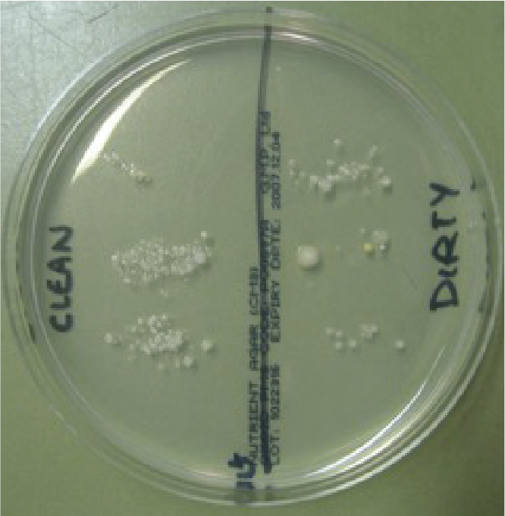
Hand Shaking Experiment – Answers 1
Hand Shaking Experiment - Answers
Section A Results Worksheet
Dirty section
Colony 1 large round cream colonies with a white centre
Colony 2 small yellow colonies
Colony 3 very small cream colonies with irregular shape
Colony 4 small cream round oval colonies
Colony 5 small round white colonies
Clean section
Colony 1 small round white colonies
Colony 2 small cream round oval colonies

Slide 14
Hand Shaking Experiment – Answers 2
Hand Shaking Experiment - Answers
Observations
Which side of the Petri dish contained the highest number of microbes?
________________________________________________________________________________________________
2. Which side of the Petri dish contained more different colonies of microbes?
________________________________________________________________________________________________
3. How many different colony types were there on the:
Clean _______________
Dirty _______________
Clean
Dirty
2
5

Slide 15
Hand Shaking Experiment – Answers 3
Hand Shaking Experiment - Answers
Conclusions
Some people may see more microbes on the clean side of the Petri dish than the dirty side. Why?
___________________________________________________________________________________________________________________________________________________
2. Which colonies would you consider the friendly microbes and why?
___________________________________________________________________________________________________________________________________________________
There may be more microbes on the clean side than the dirty side but if students have washed their hands correctly there should be a lower number of different types of microbes. The increase in the number of microbes is probably due to microbes from the water or the paper towel used to dry their hands.
The microbes on the clean side as they are probably the natural microbes found on our hands.

Slide 16
Hand Shaking Experiment – Answers 4
Hand Shaking Experiment - Answers
Section B Results Worksheet
Procedure:
Carry out the experiment according to the teacher’s instructions.
In the table below, fill in how many different types of colonies you counted on your Petri dish and draw a graph of your results.
After washing (or not washing) and shaking hands
Results | Student 1 | Student 2 | Student 3 | Student 4 | Student 5 | Student 6
No wash (control)
Quick wash
Thorough wash
Thorough wash with soap
Your results

Slide 17
Hand Shaking Experiment – Answers 5
Hand Shaking Experiment - Answers
Which method of hand hygiene eliminated the most microbes?
__________________________________________________________________________________________________
Why would soap help eliminate more microbes than washing with water alone?
__________________________________________________________________________________________________
What are the advantages and disadvantages to using antibacterial soap when washing your hands?
Advantages: _____________________________________
Disadvantages: __________________________________
Hand washing with soap and warm water.
Soap helps to break up the natural oil on your skin to which microbes can stick.
kill any unwanted microbes.
also kill natural skin microbes (note: general (non-antibacterial) soap will remove harmful microbes from the hands).

Slide 18
Hand Shaking Experiment – Answers 6
Hand Shaking Experiment - Answers
4. What evidence do you have that microbes can be transmitted by hands?
____________________________________________________________________________________________________
5. Which areas of the hand would do you think would contain the most microbes and why?
____________________________________________________________________________________________________
6. List 5 times when it is important to wash your hands:
a _________________ b __________________
c _________________ d __________________
e _________________
The types of microbes on the first plate are spread along to the other plates and the numbers are gradually decreasing.
Under the finger nails, on the thumbs and between the fingers as these are places that people either forget to wash or don’t wash very well.
Before cooking
After using the toilet
After sneezing into them
After touching pets
Before eating

Slide 19
Discussion

Slide 20
Discussion Points
What results did you find the most surprising?
Where have the microbes on your hands may come from?
Why it is important to use soap when washing our hands?
What can we use if there is no soap available?

Slide 21
Extension Activities

Slide 22
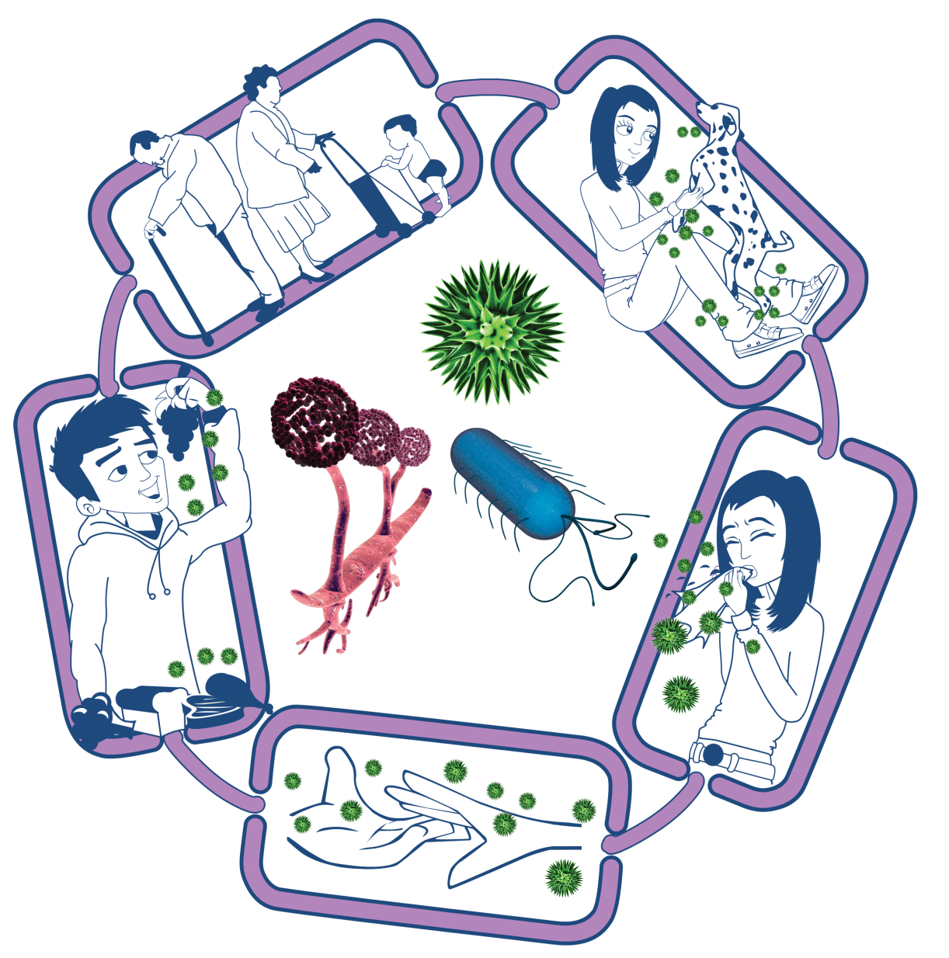
The Chain of Infection
Source of infection
Someone or something carrying the harmful microbes that causes the infection. There are many different sources of infection, these can include:
• People already infected
• Pets or animals
• Contaminated food
People at risk from
infection
We are all at risk from
infection, but some are at greater risk:
• People on medication
e.g chemotherapy
• The very young/elderly
• People with underlying diseases e.g HIV/AIDS, diabetes
Way out for microbes
Harmful microbes need a way to get out of an infected person or source before they can spread to someone else. Routes include:
• Sneezing, coughing, saliva
• Bodily fluid
• Juices from raw meat and poultry
Way in for microbes
Harmful microbes need a
way to enter the body before they can cause an infection. This can be
through:
• The food we eat
• Inhalation of aerosols
or droplets
• Open cuts or sores
• Things we put in our
mouths
Spread of infection
Harmful microbes need a way to be passed from a source to a person. This can be through:
• Direct touch/contact
• Sexual transmission
Harmful microbes are also spread via:
• Hands, hand contact surfaces (e.g. door handles, keyboards, toilets)
• Food contact surfaces
• Air

Slide 23
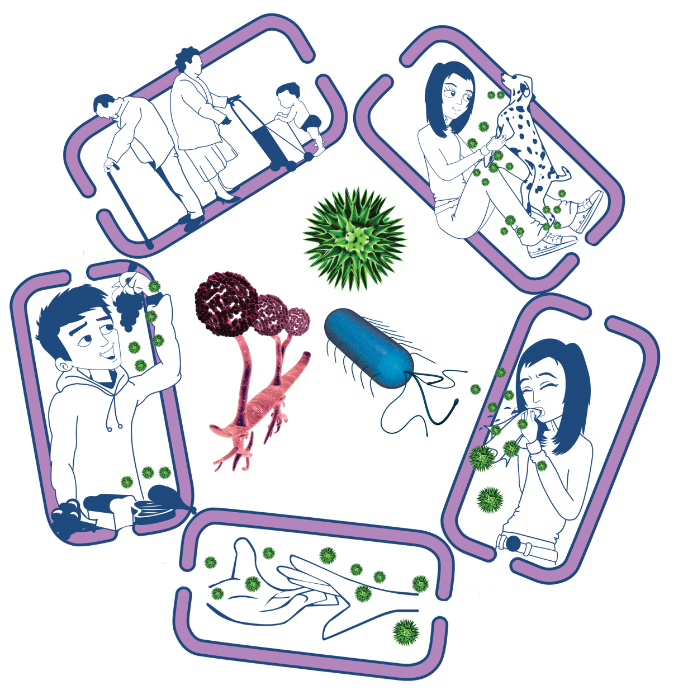
Breaking the Chain of Infection
Source of infection
• Isolate infected people
• Take care with raw food
• Wash pets regularly
• Treat pets for pathogens when needed
• Dispose of nappies and soiled clothing appropriately
People at risk from
infection
Everyone:
• Take appropriate vaccinations
High risk people:
• Keep away from people who are infectious
• Take extra care about cleanliness
• Take extra care when cooking and preparing food
Way out for microbes
Prevent any:
• Coughs and sneezes
• Faeces
• Vomit
• Bodily fluid
Getting onto surfaces or hands
Way in for microbes
• Cover cuts and open sores with a water proof dressing
• Cook food properly
• Take care to drink only clean water
Spread of infection
• Wash hands thoroughly and regularly
• Cover cuts and open sores
• Take appropriate precautions during
sexual activity

Slide 24
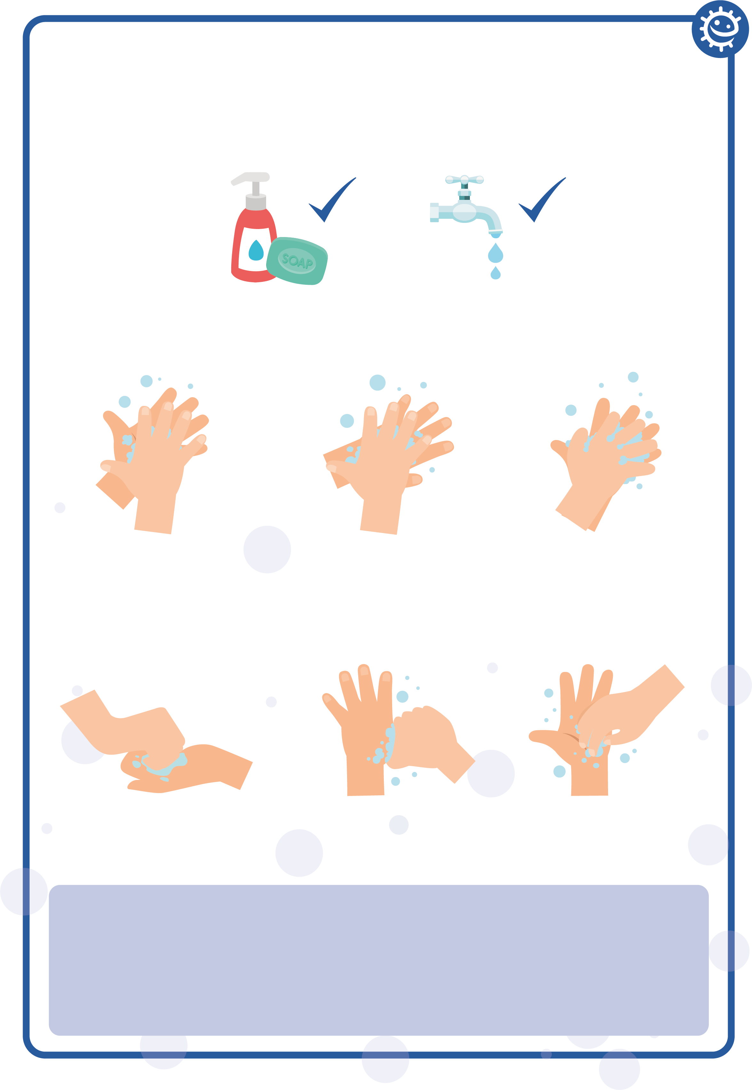
Hand Washing Poster
Wash your hands with soap and water for 20 seconds
1
2
3
Palm to palm
Back of hands
Between fingers
4
5
6
Back of fingers
Thumbs
Tip of fingers
To help keep time, sing ‘Happy Birthday’ twice

Slide 25
Learning Consolidation

Slide 26
Hand Hygiene Quiz 1
Hand Hygiene Quiz
How can you spread microbes to others?
(2 points)
By touching them
By looking at them
By speaking to them on the phone
By sneezing
Why should we use soap to wash our hands?
(2 points)
It helps remove invisible microbes too small to be seen by our eyes
It breaks up the oil on our hands which trap microbes
It keeps our hands moist
It doesn’t matter if we use soap or not

Slide 27
Hand Hygiene Quiz 2
Hand Hygiene Quiz
Which is NOT one of the 6 steps of hand washing?
(1 point)
Palm to palm
The thumbs
Arms
In between fingers
Who might be at risk as a result of you not washing your hands properly?
(1 point)
You
Your family
Your friends
All of the above

Slide 28
Hand Hygiene Quiz 3
Hand Hygiene Quiz
When should we wash our hands?
(3 points)
After stroking a pet
After sneezing or coughing
After watching TV
After using the bathroom or changing a soiled nappy
How can you stop harmful microbes from spreading?
(2 points)
Do nothing
Wash hands in water
Use hand sanitiser if soap and water are not available
Wash your hands with running water and soap

Slide 29
Hand Hygiene Quiz 4
Hand Hygiene Quiz
After we sneeze into our tissue, we should:
(2 points)
Wash our hands immediately
Dry our hands on our clothes
Take antibiotics
Put the tissue straight into the bin
How long should we wash our hands for?
(1 point)
10 seconds
20 seconds (length of Happy birthday song twice)
1 minute
5 minutes

Slide 30
Hand Hygiene Quiz 1 - Answers
Hand Hygiene Quiz - Answers
How can you spread microbes to others?
(2 points)
By touching them
By looking at them
By speaking to them on the phone
By sneezing
Why should we use soap to wash our hands?
(2 points)
It helps remove invisible microbes too small to be seen by our eyes
It breaks up the oil on our hands which trap microbes
It keeps our hands moist
It doesn’t matter if we use soap or not
✓
✓
✓
✓

Slide 31
Hand Hygiene Quiz 2 - Answers
Hand Hygiene Quiz - Answers
Which is NOT one of the 6 steps of hand washing?
(1 point)
Palm to palm
The thumbs
Arms
In between fingers
Who might be at risk as a result of you not washing your hands properly?
(1 point)
You
Your family
Your friends
All of the above
✓
✓

Slide 32
Hand Hygiene Quiz 3 - Answers
Hand Hygiene Quiz - Answers
When should we wash our hands?
(3 points)
After stroking a pet
After sneezing or coughing
After watching TV
After using the bathroom or changing a soiled nappy
How can you stop harmful microbes from spreading?
(2 points)
Do nothing
Wash hands in water
Use hand sanitiser if soap and water are not available
Wash your hands with running water and soap
✓
✓
✓
✓
✓

Slide 33
Hand Hygiene Quiz 4 - Answers
Hand Hygiene Quiz - Answers
After we sneeze into our tissue, we should:
(2 points)
Wash our hands immediately
Dry our hands on our clothes
Take antibiotics
Put the tissue straight into the bin
How long should we wash our hands for?
(1 point)
10 seconds
20 seconds (length of Happy birthday song twice)
1 minute
5 minutes
✓
✓
✓

