Slide 1
Infection Prevention and Control (IPC):
Respiratory Hygiene
Key Stage 3

Slide 2
Learning Intention
All pupils will:
Understand how microbes can cause illness, how infections spread, and the importance of good hygiene practices in preventing transmission.

Slide 3
Northern Ireland Curriculum Links
Curriculum Key Elements
Personal Health and Moral Character
Curriculum Skills
Communication, Managing Information, Thinking, Problem Solving and Decision-Making, Working with others
Curriculum Areas of Learning
Learning for Life and Work (Personal Development: Personal Health) (Home Economics: Healthy Eating), Science and Technology (Science: Organisms and Health)

Slide 4
How Microbes Spread When We Sneeze?
Many diseases are airborne and spread in tiny droplets of water, which are coughed and sneezed into the air by people.
Diseases that spread in this way range from viral diseases like colds and flu to rarer, more serious infections like meningitis or tuberculosis (TB) which are caused by bacteria and can result in death.
Colds and flu are caused by a virus and not bacteria and, as such, cannot be cured by antibiotics.
It is very important for everyone’s health that people cover their mouth and nose when they cough and sneeze as this can reduce the spread of infection.

Slide 5
Main Activity:
Snot Gun

Slide 6

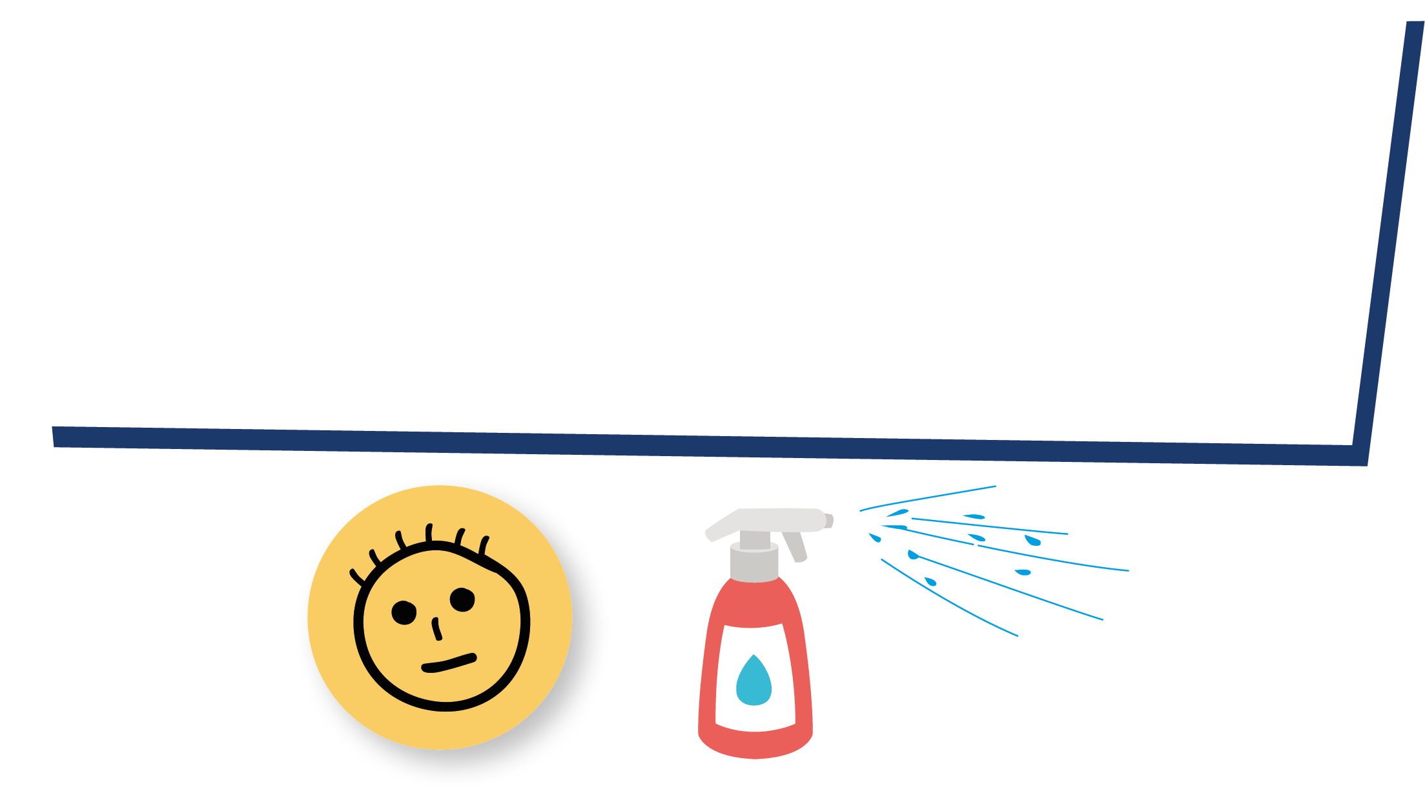
Snot Gun Steps
1. Write your name on a sticky note and place on runway
2. Spray the bottle from the end of runway
3. Measure the distance
4. Spray the bottle with hand of glove over nozzle
5. Spray the bottle with kitchen towel over the nozzle

Slide 7

Snot Gun Experiment - Questions
Snot Gun Experiment
Questions
Which disk do you think will be most affected by the sneeze?
________________________________________________
Which people do you think will be least affected by the sneeze?
________________________________________________
What do you think will happen when you place a gloved hand over the sneeze?
________________________________________________
What do you think will happen when you place a tissue over the sneeze?
________________________________________________

Slide 8
Snot Gun Experiment – Results 1
Snot Gun Experiment
Results
What was the furthest distance the sneeze travelled?
 | Distance travelled | Number of people contaminated
Sneeze alone
Gloved hand
Tissue

Slide 9
Snot Gun Experiment – Results 2
Snot Gun Experiment
2. Did any of the sneezes contaminate any of the people on the side lines? If so, how many?
3. How many ‘microbes’ landed on the person behind the sneezer?
____________________________________________________________________________________________________
Sneeze alone
Gloved hand
Tissue

Slide 10
Snot Gun Experiment - Conclusions
Snot Gun Experiment
Conclusions
Based on this experiment what have you learnt about microbial transmission?
________________________________________________
If we don’t wash our hands after sneezing into them, what might happen?
________________________________________________
Which method is best for preventing the spread of infection, sneezing into your hand or sneezing into a tissue? Why?
________________________________________________

Slide 11
Snot Gun Experiment 1 - Answers
Snot Gun Experiment - Answers
Questions
Which disk do you think will be most affected by the sneeze?
________________________________________________
Which people do you think will be least affected by the sneeze?
________________________________________________
What do you think will happen when you place a gloved hand over the sneeze?
________________________________________________
What do you think will happen when you place a tissue over the sneeze?
________________________________________________
The paper disks directly in front of and to the sides of the sneezer will be the most affected.
The person behind the sneezer and those furthest away.
The sneeze will not travel to as many people but the microbes will be found on the hand.
All the microbes will be trapped in the tissue.

Slide 12
Snot Gun Experiment 2 - Answers
Snot Gun Experiment - Answers
Results
What was the furthest distance the sneeze travelled?
 | Distance travelled | Number of people contaminated
Sneeze alone
Gloved hand
Tissue
This will vary depending on the type of spray bottle used, but in general the sneeze alone will infect more people and travel the furthest. The sneeze in the tissue should affect the least.

Slide 13
Snot Gun Experiment 3 - Answers
Snot Gun Experiment - Answers
2. Did any of the sneezes contaminate any of the people on the side lines? If so, how many?
3. How many ‘microbes’ landed on the person behind the sneezer?
____________________________________________________________________________________________________
Sneeze alone
Gloved hand
Tissue
This will vary depending on the type of spray bottle used, but in general the sneeze alone will infect more people and travel the furthest. The sneeze in the tissue should affect the least.
Your results from experiment in class.

Slide 14
Snot Gun Experiment 4 - Answers
Snot Gun Experiment - Answers
Conclusions
Based on this experiment what have you learnt about microbial transmission?
________________________________________________
If we don’t wash our hands after sneezing into them, what might happen?
________________________________________________
Which method is best for preventing the spread of infection, sneezing into your hand or sneezing into a tissue? Why?
________________________________________________
Microbes can pass very easily from person to person through sneezing and touch.
We can still transfer the harmful microbes found in a sneeze to other people when we touch them.
Sneezing into a tissue; this causes the microbes to get trapped and we can then throw the tissue away.

Slide 15
Discussion

Slide 16
Discussion Points
Were you surprised by the results in the activity?
What has this experiment taught you about the transmission of microbes?
How many students would have been infected by a sneeze?
Would there be a change in the results if the experiment was carried out outside on a windy day?

Slide 17
Fascinating Fact
Lower respiratory infections remain the world’s most deadly communicable (infectious) disease, ranked as the 4th leading cause of death. In 2019 it claimed 2.6 million lives.

Slide 18
Extension Activities

Slide 19
Spread of Infection on a Cruise Discussion
Imagine that you are on a Mediterranean cruise that will call at ports in Spain, France, Italy, Malta and Greece. At each port-of-call passengers can get off for shore excursions. On the cruise there are:
  A family of 4 on their way back to Australia.
  12 passengers planning an onward journey from Greece to Turkey.
  4 passengers planning an interrailing excursion through Hungary, Czech Republic and Germany.
  The remaining passengers plan to return to the USA
On this cruise one man has a new strain of the influenza virus and it is very contagious.
  Hypothesise and consider how many people will he infect and how far will this virus travel in 24 hours, and in 1 week?
  What could have been done to prevent the infection travelling so far?

Slide 20
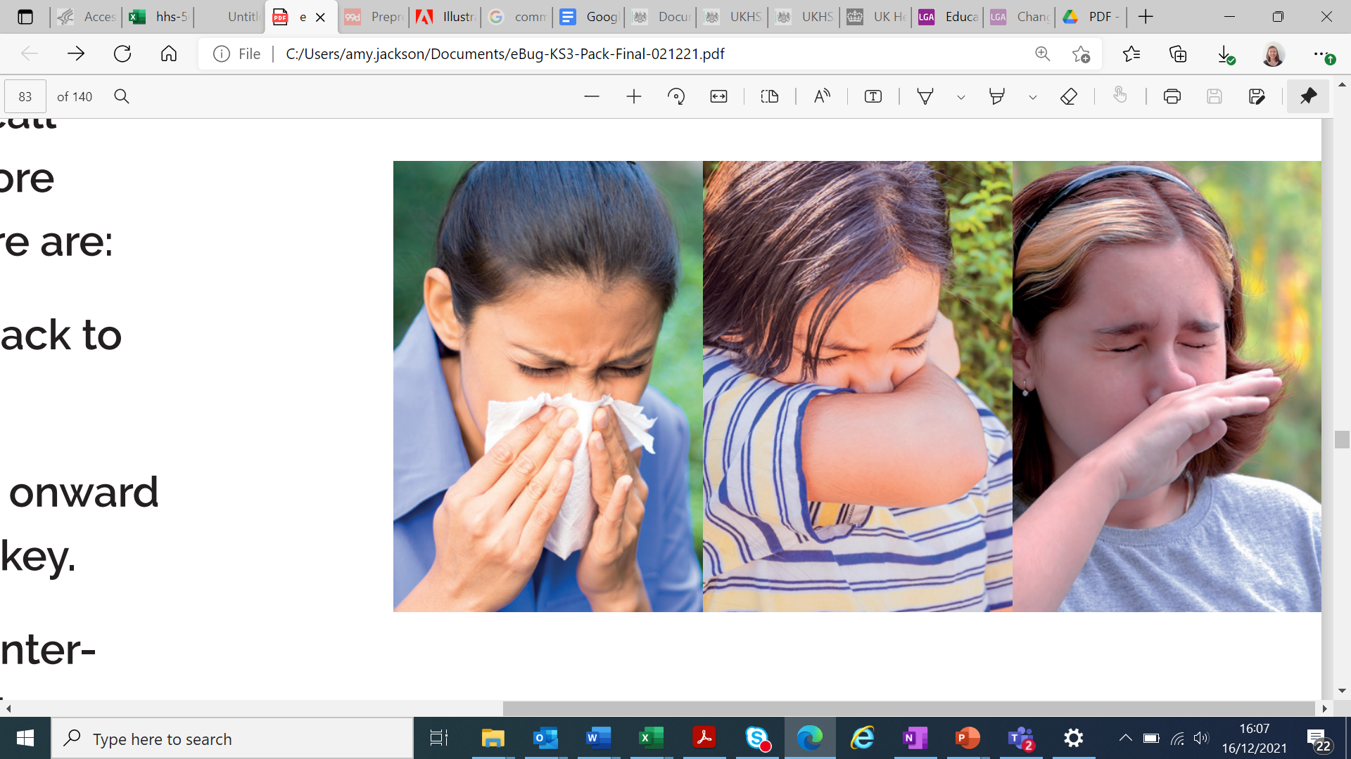
Respiratory Hygiene Best Practice
Three school friends, Sara, Elisa and Chloe, have all caught a cold and are coughing a lot. As you can see from the picture below, each student has adopted a different way of covering their coughs and sneezes. One is sneezing into a tissue, one into their elbow, and one on their hand.
Discuss the advantages and disadvantages of each method in the context of:
  Their daily life
  Reducing the spread of infection.

Slide 21
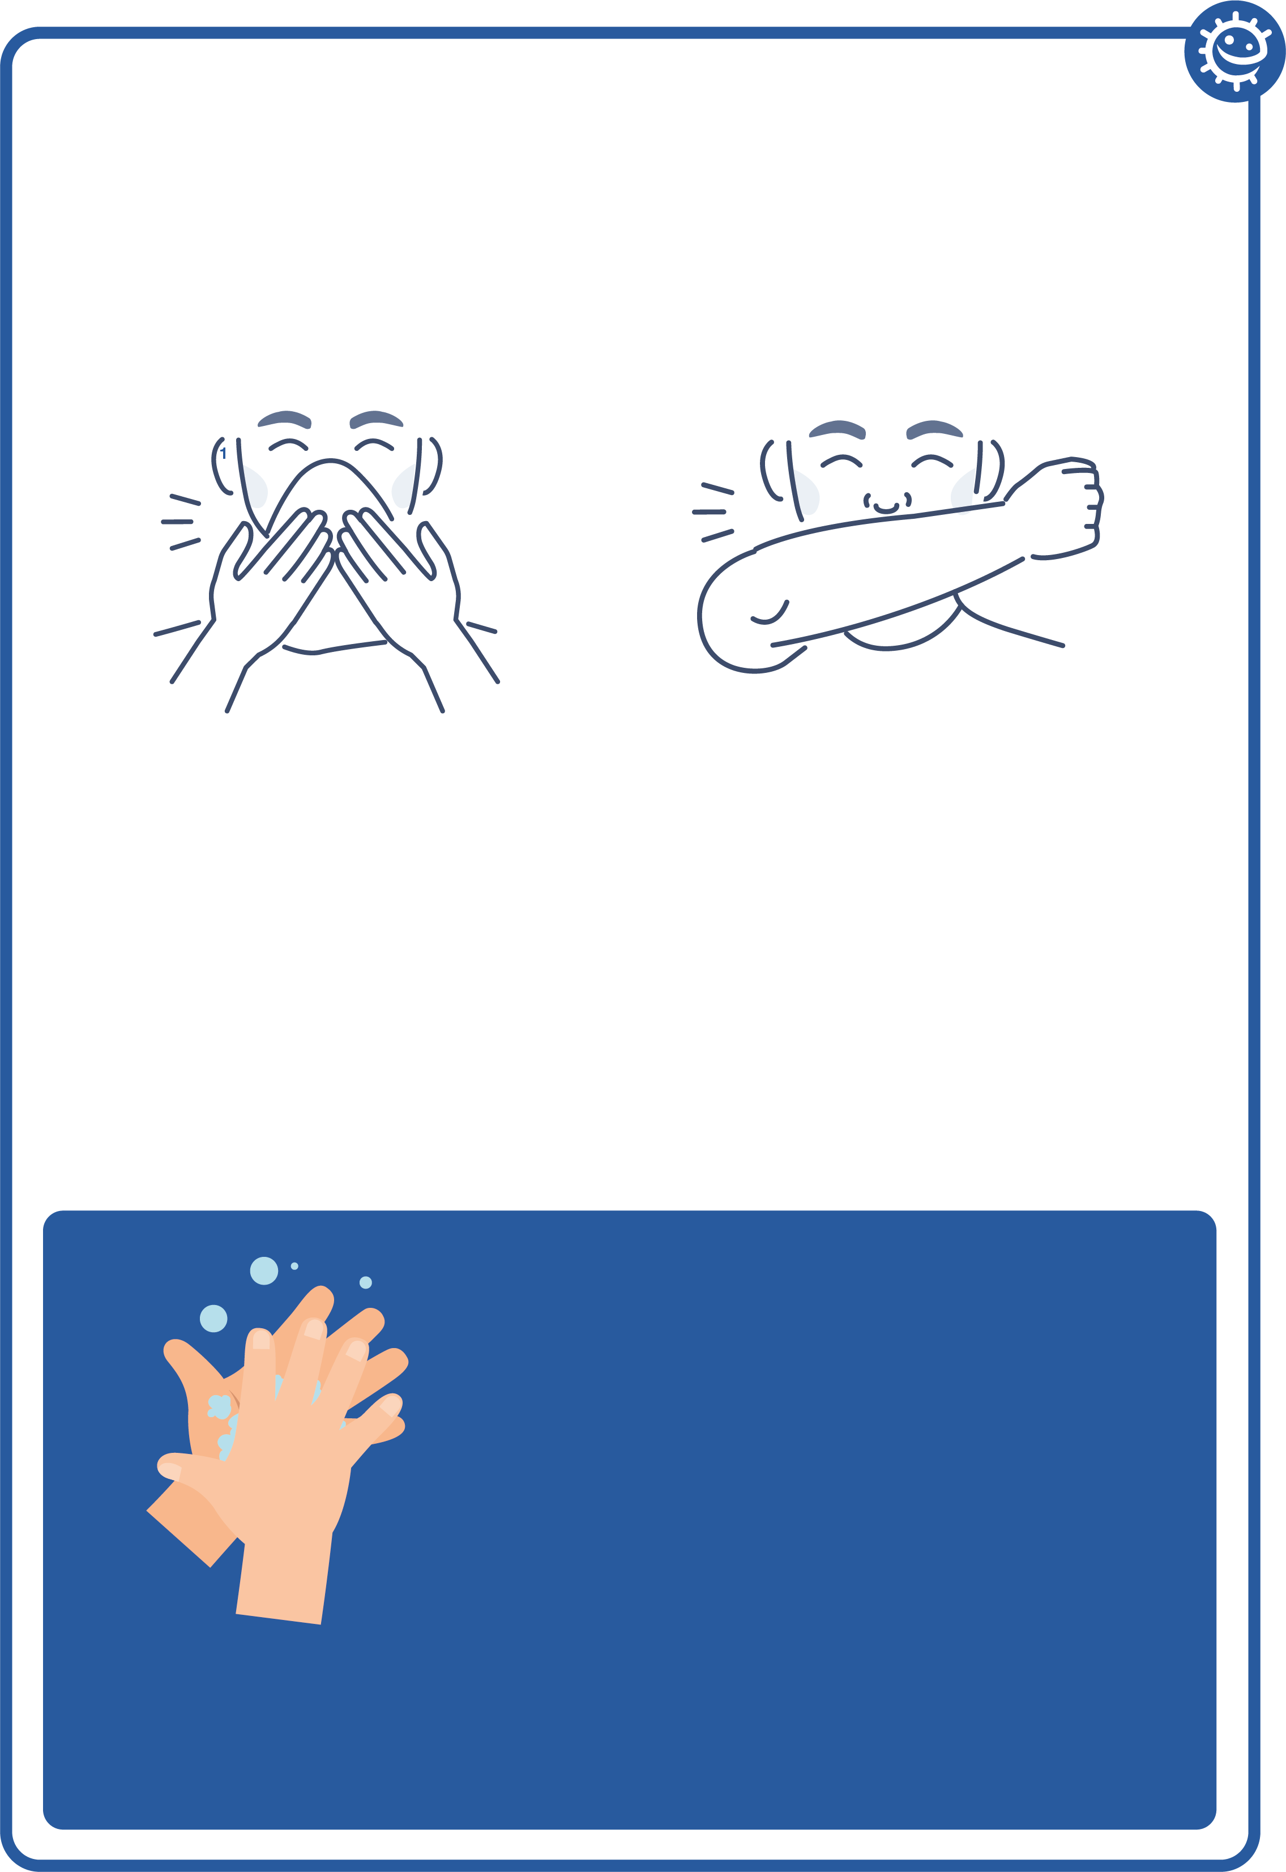
Respiratory Hygiene Poster
Cover your coughs and sneezes
1
Use a tissue if you have one
If you have no tissue use your sleeve
2
Wash your hands
for 20 seconds with
soap and water.
To help keep time -
sing ‘Happy
Birthday’ twice

Slide 22
Respiratory Hygiene Quiz
Respiratory Hygiene Quiz 1
How can you spread microbes to others?
(3 points)
Touching
Sleeping
Sneezing
Coughing
After we sneeze into our hands, we should:
(2 points)
Wash our hands
Dry our hands on our clothes
Take antibiotics
None of the above is necessary

Slide 23
Respiratory Hygiene Quiz 2
Respiratory Hygiene Quiz
If you do not have a tissue available, the next best option is to sneeze:
(1 point)
Into your hands
Into your sleeve
Into an empty space
Onto your desk
The best way to stop microbes from spreading is:
(2 points)
To use your hand to cover your sneeze
To use a tissue to cover your sneeze
To use a sleeve if you haven’t got a tissue
To drink plenty of fluids

Slide 24
Respiratory Hygiene Quiz 3
Respiratory Hygiene Quiz
What should you do with a tissue after sneezing into it?
(1 point)
Put it in your pocket for next time
Put it straight in the bin
Put it up your sleeve for next time
Any of the above
What might happen if we don’t wash our hands after sneezing into them?
(1 point)
Nothing
Transfer harmful microbes to other people
Help protect our microbes

Slide 25
Respiratory Hygiene Quiz – Answers 1
Respiratory Hygiene Quiz - Answers
How can you spread microbes to others?
(3 points)
Touching
Sleeping
Sneezing
Coughing
After we sneeze into our hands, we should:
(1 point)
Wash our hands
Dry our hands on our clothes
Take antibiotics
None of the above is necessary
✓
✓
✓
✓

Slide 26
Respiratory Hygiene Quiz – Answers 2
Respiratory Hygiene Quiz - Answers
If you do not have a tissue available, the next best option is to sneeze:
(1 point)
Into your hands
Into your sleeve
Into an empty space
Onto your desk
The best way to stop microbes from spreading is:
(2 points)
To use your hand to cover your sneeze
To use a tissue to cover your sneeze
To use a sleeve if you haven’t got a tissue
To drink plenty of fluids
✓
✓
✓

Slide 27
Respiratory Hygiene Quiz – Answers 3
Respiratory Hygiene Quiz - Answers
What should you do with a tissue after sneezing into it?
(1 point)
Put it in your pocket for next time
Put it straight in the bin
Put it up your sleeve for next time
Any of the above
What might happen if we don’t wash our hands after sneezing into them?
(1 point)
Nothing
Transfer harmful microbes to other people
Help protect our microbes
✓
✓

Slide 28
Learning Consolidation

Slide 29
Discussion Activity
Create Some Simple Rules or Messages to Reduce the Spread of Coughs, Colds and Flu in Your School.
Coughs and sneezes spread diseases;
Catch it, bin it, kill it;
Cover my coughs and sneezes with a tissue or cough/sneeze into the crook of my elbow or sleeve (not my hand);
Wash my hands after a cough or a sneeze or use hand sanitiser.

Slide 30
Germ Defence
The website germdefence.org can be used as a tool to help you reduce the likelihood of getting colds, flu and stomach upsets, and from transmitting them on to other people. You can follow simple steps and can print or download a summary of the information you have reviewed.

