Slide 1
Infection Prevention and Control (IPC):
Vaccinations
Key Stage 3

Slide 2
Learning Intention
All pupils will:
• Understand the body’s natural defences against infection, the role of vaccines and natural immunity in preventing disease, and the limitations of vaccines for certain common infections.

Slide 3
Northern Ireland Curriculum Links
Curriculum Key Elements
Personal Health and Moral Character
Curriculum Skills
Communication, Managing Information, Thinking, Problem Solving and Decision-Making, Working with others
Curriculum Areas of Learning
Learning for Life and Work (Personal Development: Personal Health), Science and Technology (Science: Organisms and Health)

Slide 4
Importance of Vaccines (1/2)
Why it is Important to get Vaccinated?
Immune means that you are protected from the serious effects of infection and that immunisation is a way of increasing the body’s protective immunity to both bacterial and viral diseases.
Vaccines are a small, inactive and harmless amount of the microbe/disease which teaches our body how to fight the harmful microbe when or if we get attacked by the disease.

Slide 5
Importance of Vaccines (2/2)
Why it is Important to get Vaccinated?
Antibodies pass from mother to child through the placenta in the womb and breast milk after birth helping to protect new-born babies from disease. However, this doesn’t work for all diseases, e.g. women are given a vaccine when they are pregnant to protect their unborn baby from whooping cough. This will provide protection from when the baby is born until they are old enough to have their own vaccine (8 weeks old).
Each type of microbe has an outer coating which is unique to the microbe, but because some microbes change their outer coats so quickly, it is difficult for scientists to make vaccines for these infections, or, like the flu vaccine, a new one has to be made each year.

Slide 6
Main Activity:
Herd Immunity Class Stimulation

Slide 7

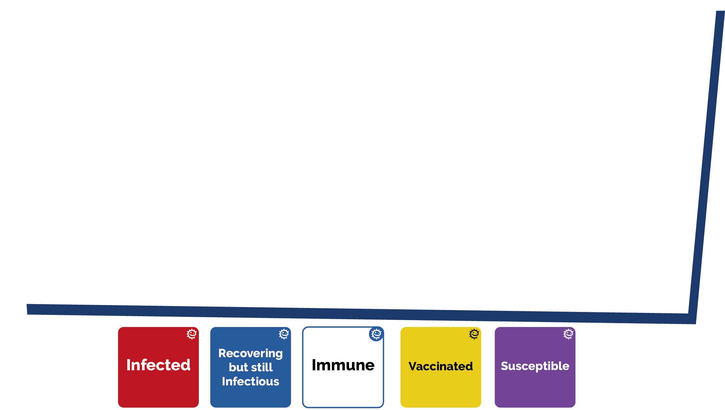
Herd Immunity Activity Steps
1. Make sure everyone has a red, white, blue, and yellow card
3. A person in the middle of the room raises their hand with the red card
6. Continue the game by holding blue recovering cards to mark day 2
2. 25% of the class will have the yellow ‘vaccinated’ card and 75% the purple ‘susceptible’ card – don’t let anyone see what card you have
4. The people next to the red card are now ‘infected’, and so on
7. Now, repeat the game with 50% and 75% vaccinated. What do you notice?
5. Only ‘vaccinated’ people are not infected

Slide 8
Coloured Cards
Infected
Recovering but still infectious
Immune
Susceptible
Vaccinated

Slide 9

Herd Immunity Activity 1
Herd Immunity Scenario
Use this sheet to record your observations after each stage of the scenario. Then add your conclusions.
Number of Students Vaccinated
Day | 25% |  | 50% |  | 75%
1
2
3
4
5
6
7

Slide 10
Herd Immunity Activity 2
Herd Immunity Scenario
As more people get vaccinated, what happens to the spread of the infection?
____________________________________________________________________________________________________________________________________________________________________________________________________________________________________
Draw a graph to illustrate the results.

Slide 11
Herd Immunity Activity 3
Herd Immunity Scenario
Conclusions
What is herd immunity?
____________________________________________________________________________________
What happens when vaccination drops to a low level within the community?
__________________________________________
Why is a vaccine regarded as a preventative measure and not a treatment?
____________________________________________________________________________________

Slide 12
Herd Immunity Activity – Answers 1
Herd Immunity Scenario - Answers
Use this sheet to record your observations after each stage of the scenario. Then add your conclusions.
Number of Students Vaccinated
Day | 25% |  | 50% |  | 75%
1
2
3
4
5
6
7
The results in this table will vary depending on the number of people in the class and where the vaccinated people are positioned in relation to the susceptible people. There will however be a decreasing trend of infected people as more people get vaccinated.

Slide 13
Herd Immunity Activity – Answers 2
Herd Immunity Scenario - Answers
As more people get vaccinated, what happens to the spread of the infection?
__________________________________________________________________________________________________________________________________________________________________________________________________________________________________________________________________________
Draw a graph to illustrate the results.
Vaccination programmes make it extremely difficult for diseases to spread in a community. As more people get vaccinated or become infected and develop natural immunity they become immune to the disease therefore the disease cannot spread.
Your graph

Slide 14
Herd Immunity Activity – Answers 3
Herd Immunity Scenario - Answers
Conclusions
What is herd immunity?
____________________________________________________________________________________
What happens when vaccination drops to a low level within the community?
__________________________________________
Why is a vaccine regarded as a preventative measure and not a treatment?
____________________________________________________________________________________
Herd immunity (or community immunity) describes a type of immunity that occurs when vaccination of a portion of the population or becoming infected and developing natural immunity, provides protection to unprotected individuals.
When the vaccination drops to a low level, people start contracting the disease again leading to a re-emergence of the disease.
Vaccines are used to boost the body’s immunity so that when a microbe does enter the body, the immune system is ready to fight it preventing the microbe from causing serious infection.

Slide 15
Discussion

Slide 16
Discussion Points
Why is vaccination not only a personal health issue but also a public health issue?
What needs to be done to completely eliminate an infectious disease?
Why hasn’t the flu vaccine eliminated the influenza virus?

Slide 17
Extension Activities

Slide 18
Study the world map and record the vaccines that are required for specific countries in each region. Also name the disease that the vaccine provides protection for and the microbe that causes the disease. If needed use government, NHS, World Health Organisation and UK Health Security Agency websites to help you to investigate current vaccine information.
World Map

Slide 19
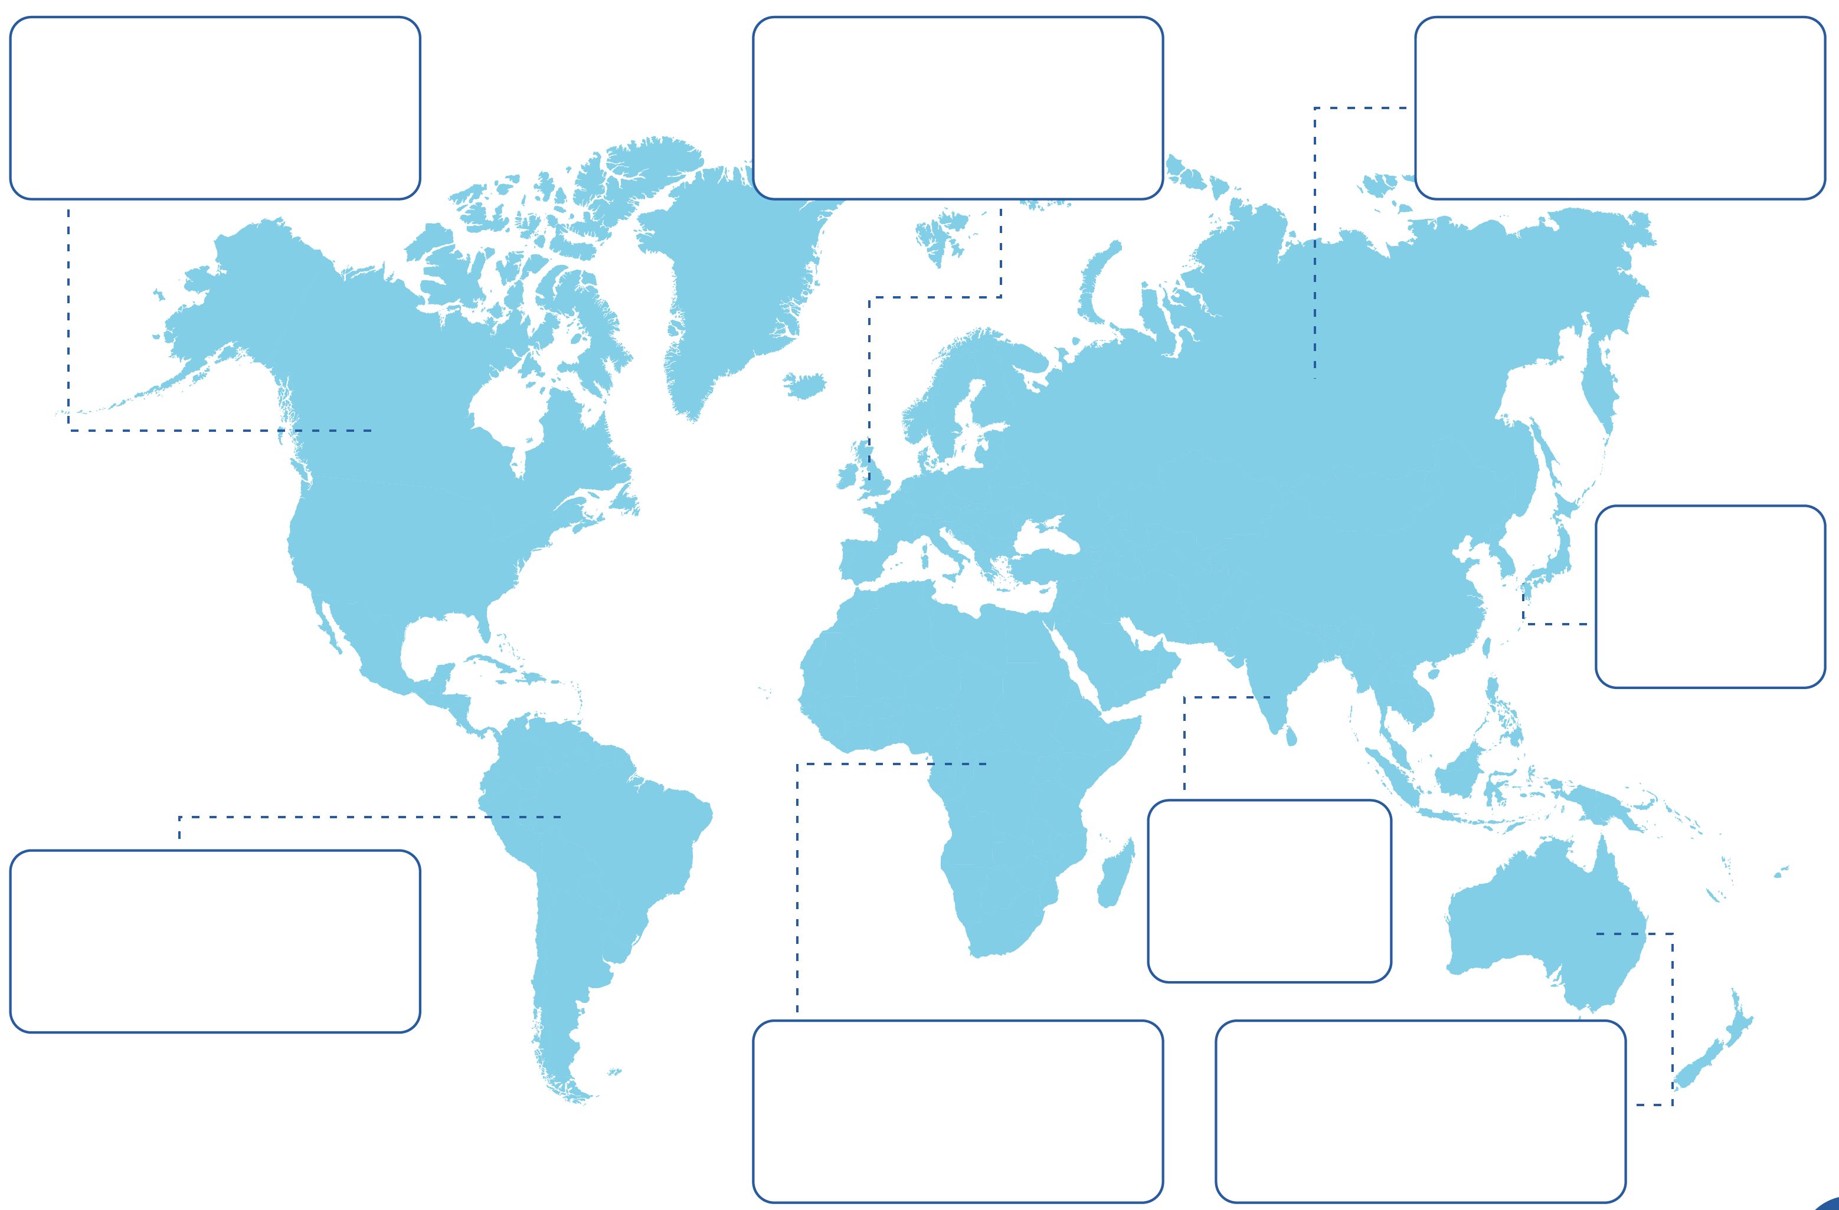
World Map Question Sheet
Canada
Western Europe
Russia
Far East
Asia
S. America
Africa
Australia
Answers

Slide 20
World Map Answer Sheet - Canada
Canada
Western Europe
Russia
Canada:
MMR; DTaP (Diphtheria, Tetanus and Polio); Typhoid; Hep. A; Hep. B; Rabies
Far East
Asia
S. America
Africa
Australia
Next

Slide 21
World Map Answer Sheet – S America
Canada
Western Europe
Russia
South America:
MMR; DTaP; Typhoid; Hep. A; Hep. B; Rabies; Yellow Fever; Malaria
Far East
Asia
S. America
Africa
Australia
Next

Slide 22
World Map Answer Sheet – W Europe
Canada
Western Europe
Russia
Western Europe:
MMR; DTaP; Typhoid; Hep. A; Hep. B; Rabies;
Far East
Asia
S. America
Africa
Australia
Next

Slide 23
World Map Answer Sheet - Africa
Canada
Western Europe
Russia
Africa:
MMR; DTaP; Typhoid; Hep. A; Hep. B; Rabies; Yellow Fever; Encephalitis; Cholera; Meningitis;
Far East
Asia
S. America
Africa
Australia
Next

Slide 24
World Map Answer Sheet - Russia
Canada
Western Europe
Russia
Russia:
DTaP; Typhoid; Hep. A; Hep. B; Rabies; Encephalitis;
Far East
Asia
S. America
Africa
Australia
Next

Slide 25
World Map Answer Sheet – Far East
Canada
Western Europe
Russia
Far East:
MMR; DTaP; Typhoid; Hep. A; Hep. B; Rabies; Encephalitis;
Far East
Asia
S. America
Africa
Australia
Next

Slide 26
World Map Answer Sheet - Asia
Canada
Western Europe
Russia
Asia:
MMR; DTaP; Typhoid; Hep. A; Hep. B; Rabies; Encephalitis; Cholera;
Far East
Asia
S. America
Africa
Australia
Next

Slide 27
World Map Answer Sheet - Australia
Canada
Western Europe
Russia
Australia:
MMR; DTaP; Typhoid; Hep. A; Hep. B; Rabies; Encephalitis;
Far East
Asia
S. America
Africa
Australia

Slide 28
World Map Answers Sheet
Canada
Western Europe
Russia
MMR; DTaP (Diphtheria, Tetanus and Polio); Typhoid; Hep. A; Hep. B; Rabies.
DTaP; Typhoid; Hep. A; Hep. B; Rabies; Encephalitis
MMR; DTaP; Typhoid; Hep. A; Hep. B; Rabies
Far East
MMR; DTaP; Typhoid; Hep. A; Hep. B; Rabies; Encephalitis
Asia
S. America
MMR; DTaP; Typhoid; Hep. A; Hep. B; Rabies; Encephalitis; Cholera
MMR; DTaP; Typhoid; Hep. A; Hep. B; Rabies; Yellow Fever; Malaria.
Africa
MMR; DTaP; Typhoid; Hep. A; Hep. B; Rabies; Yellow Fever; Encephalitis; Cholera; Meningitis.
Australia
MMR; DTap; Typhoid; Hep. A; Hep. B; Rabies; Encephalitis

Slide 29
Learning Consolidation

Slide 30
Write a Paragraph or Three Statements to Summarise What You Have Learned During the Lesson.


