Slide 1


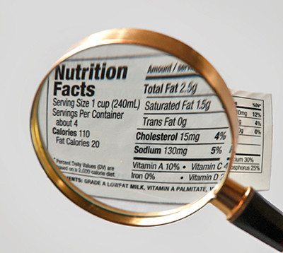

Food Hygiene & Safety
Food safety versus food quality
This project has received funding from the European Union’s Horizon 2020 research and innovation programme under grant agreement No 727580

Slide 2
Learning Intention
To understand the importance of food labels, the differences between food safety and food quality and how proper storage and usage of food help prevent risks associated with improper handling.

Slide 3
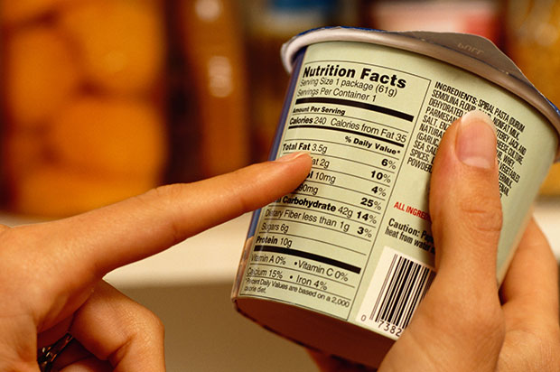
What are the components of a label?
What the food is
Name of food (branding)
Description of food
Food identity
How to handle the food safely
How to store food
How long food can be kept
How to cook food
Allergens
Food hygiene and safety and other instructions
Nutritional information
What the food provides
Food ingredients
Breakdown of calories and nutrients
Why are these labels important?
Notes:
Labels are a daily part of our life but what information do they tell us and why are they important?
Food identity – important to know what you are buying, food producers are under strict rules on the wording they can use to describe food, an example is a strawberry yoghurt - is it a strawberry flavoured product or does it contain strawberries?
Food hygiene and safety instructions help us to know how to handle and cook the food safely, and the allergens
Nutritional information tell us the nutritional information of food and calories – the traffic light system is helpful when making healthy food choices
This lesson will focus on food safety labels but its good to think about these in the full context of food labelling

Slide 4
Cast your votes:
1. What does ‘Best before’ mean?
The food will be safe to eat up to this date, but should not be eaten past this date
The food can be consumed after this date but it may no longer be at its best quality
It depends on the type of food
None of these
Don’t know
Notes:
To make this more interactive we have put these two question on kahoot:
https://create.kahoot.it/share/food-quality-vs-food-safety-vote/25db61a7-6d24-40ce-95c1-1a078b7804d6
Follow the link and choose classic (player vs player) ask students to join by going on their smart phone/tablet and visiting www.kahoot.it or the kahoot app and typing in the game PIN
You will get answers in real time – it may prevent students from guessing the same as others

Slide 5
Cast your votes:
2. What does ‘Use by’ mean?
The food will be safe to eat up to this date, but should not be eaten past this date
The food can be consumed after this date but it may no longer be at its best quality
It depends on the type of food
None of these
Don’t know
Notes:
To make this more interactive we have put these two question on kahoot:
https://create.kahoot.it/share/food-quality-vs-food-safety-vote/25db61a7-6d24-40ce-95c1-1a078b7804d6
Follow the link and choose classic (player vs player) ask students to join by going on their smart phone/tablet and visiting www.kahoot.it or the kahoot app and typing in the game PIN
You will get answers in real time – it may prevent students from guessing the same as others

Slide 6
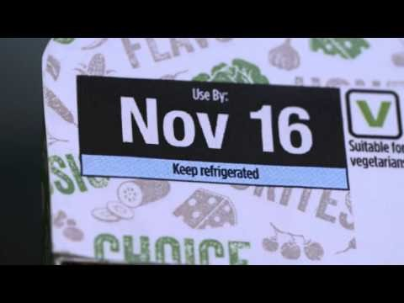
What are the correct definitions?
After watching the video, complete the worksheet:
What are the definitions of ‘Best before’ and ‘use by’?
What does food safety and food quality mean?
Notes:
The video is imbedded in the slide, if it does not work please visit the video: ‘Food Standard Scotland Date Labels’: https://www.youtube.com/watch?v=mDvtwj_PpN8&t=2s

Slide 7

What happens if we don’t follow the labels?
In pairs discuss and feedback to the class:
Are there any consequences of eating food past the ‘use by’ date?
Are they any consequences of eating food past the ‘best before’ date?
  As a class, vote:
  Would you throw away food that is past its ‘best before’ date?
  Would you throw away food that is past its ‘use by’ date?

Slide 8
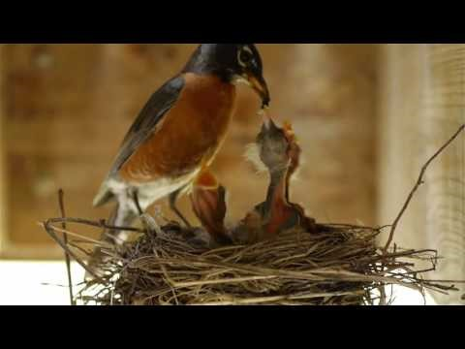
Food waste is a problem
In the UK we throw away 7 million tonnes of food and drink from our homes each year. It costs each of us an extra £500 per year
Around 1 third of the world’s food production is lost or wasted
By 2050 the global population could be over 9.5 billion
What can we do as consumers to reduce food waste?
Notes:
Food standard agency:
Food waste (2016): https://www.youtube.com/watch?v=5vMsLHPbywk

Slide 9
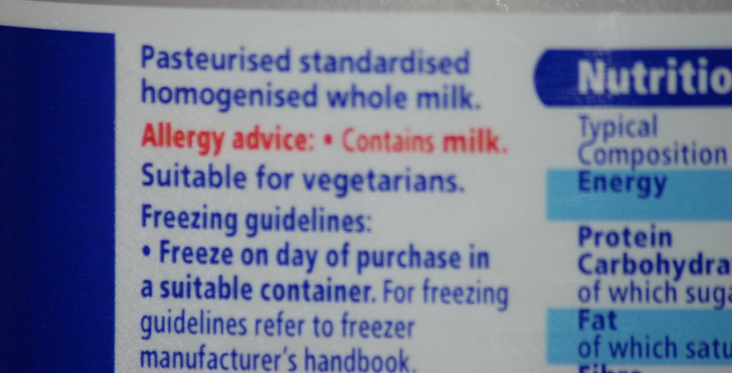
Tackle food waste with freezing
Check the label to see if the food can be frozen
How does freezing keep the food safe to eat?
Freezing will stop microbes that can make you ill, such as bacteria, from growing in the food, but may not kill them
How can you ensure food is safe to eat when defrosting?
You should aim to eat frozen food within 6 months to prevent waste - It will still be safe to eat after this time but the quality may have deteriorated
Freezing hits the pause button on microbial growth however, bacteria are not killed, and foods should be consumed within 24 hours of defrosting
Always defrost food in the fridge, microbes grow at room temperature
Notes:
Freezing is a great way to tackle food waste.
Freezing will stop the growth of bacteria but may not kill it.
Microbes can grow at room temperature in food
If the frozen food is being cooked, treat it as you would fresh food and ensure it is thoroughly cooked e.g. frozen chicken – wash hands after handling and use separate chopping boards.
Before you serve pork, poultry and minced meat, make sure it is steaming hot and cooked all the way through. When you cut into the thickest part of the meat, check that none of the meat is pink and that any juices run clear. In a whole bird this is the area between the leg and the breast. You could also use a temperature probe (if you have one) to check the temperature of the thickest part of the meat. The temperature needs to reach one of the following combinations to make sure it has been cooked properly:
60°C for 45 minutes
65°C for 10 minutes
70°C for 2 minutes
75°C for 30 seconds
80°C for 6 seconds
How can you keep track of what you have frozen and when?
Add a label with the date of what it is, and when you put it in the freezer.

Slide 10
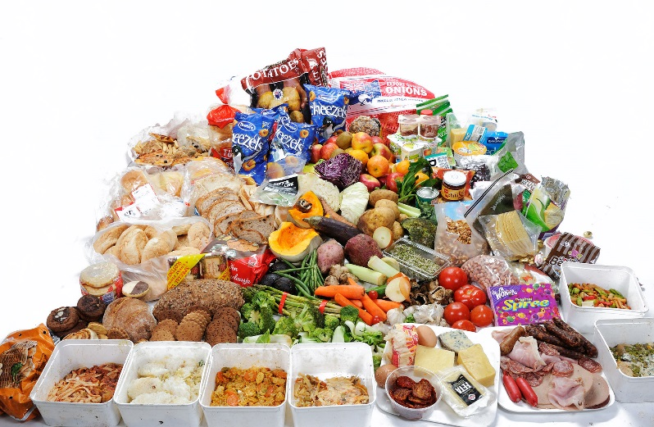
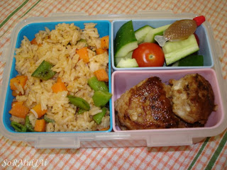
Tackling food waste or foodborne illness
In groups discuss either:
Things we can do to reduce food waste at home
Things we can do to prevent foodborne illness
Make a poster or mind map with your ideas, including pictures and diagrams
Present your ideas to the class
Notes:
Optional activity if time allows: this could also be given as homework if there is a lack of time

